Slide 1

Preliminary 2026 Pacific Salmon Outlook

Slide 2
INTRODUCTION
Purpose of the Outlook
Provide expected salmon abundance for 2026 to Inform harvest planning and management decisions
Combine categorical abundance based on expert opinion and statistical forecast, where available

Slide 3
INTRODUCTION
Contributors
Stock assessment biologists across the Region
Collaborative programs with First Nations
Other stakeholders and stewardship groups

Slide 4
INTRODUCTION
How Outlooks Are Defined
By Stock Management Unit (SMU)
By Conservation Unit (CU), if data available
Biological and management reference points are used to assign Outlook category, where available
SMUs without references have categorical Outlooks assigned based on expert opinion

Slide 5
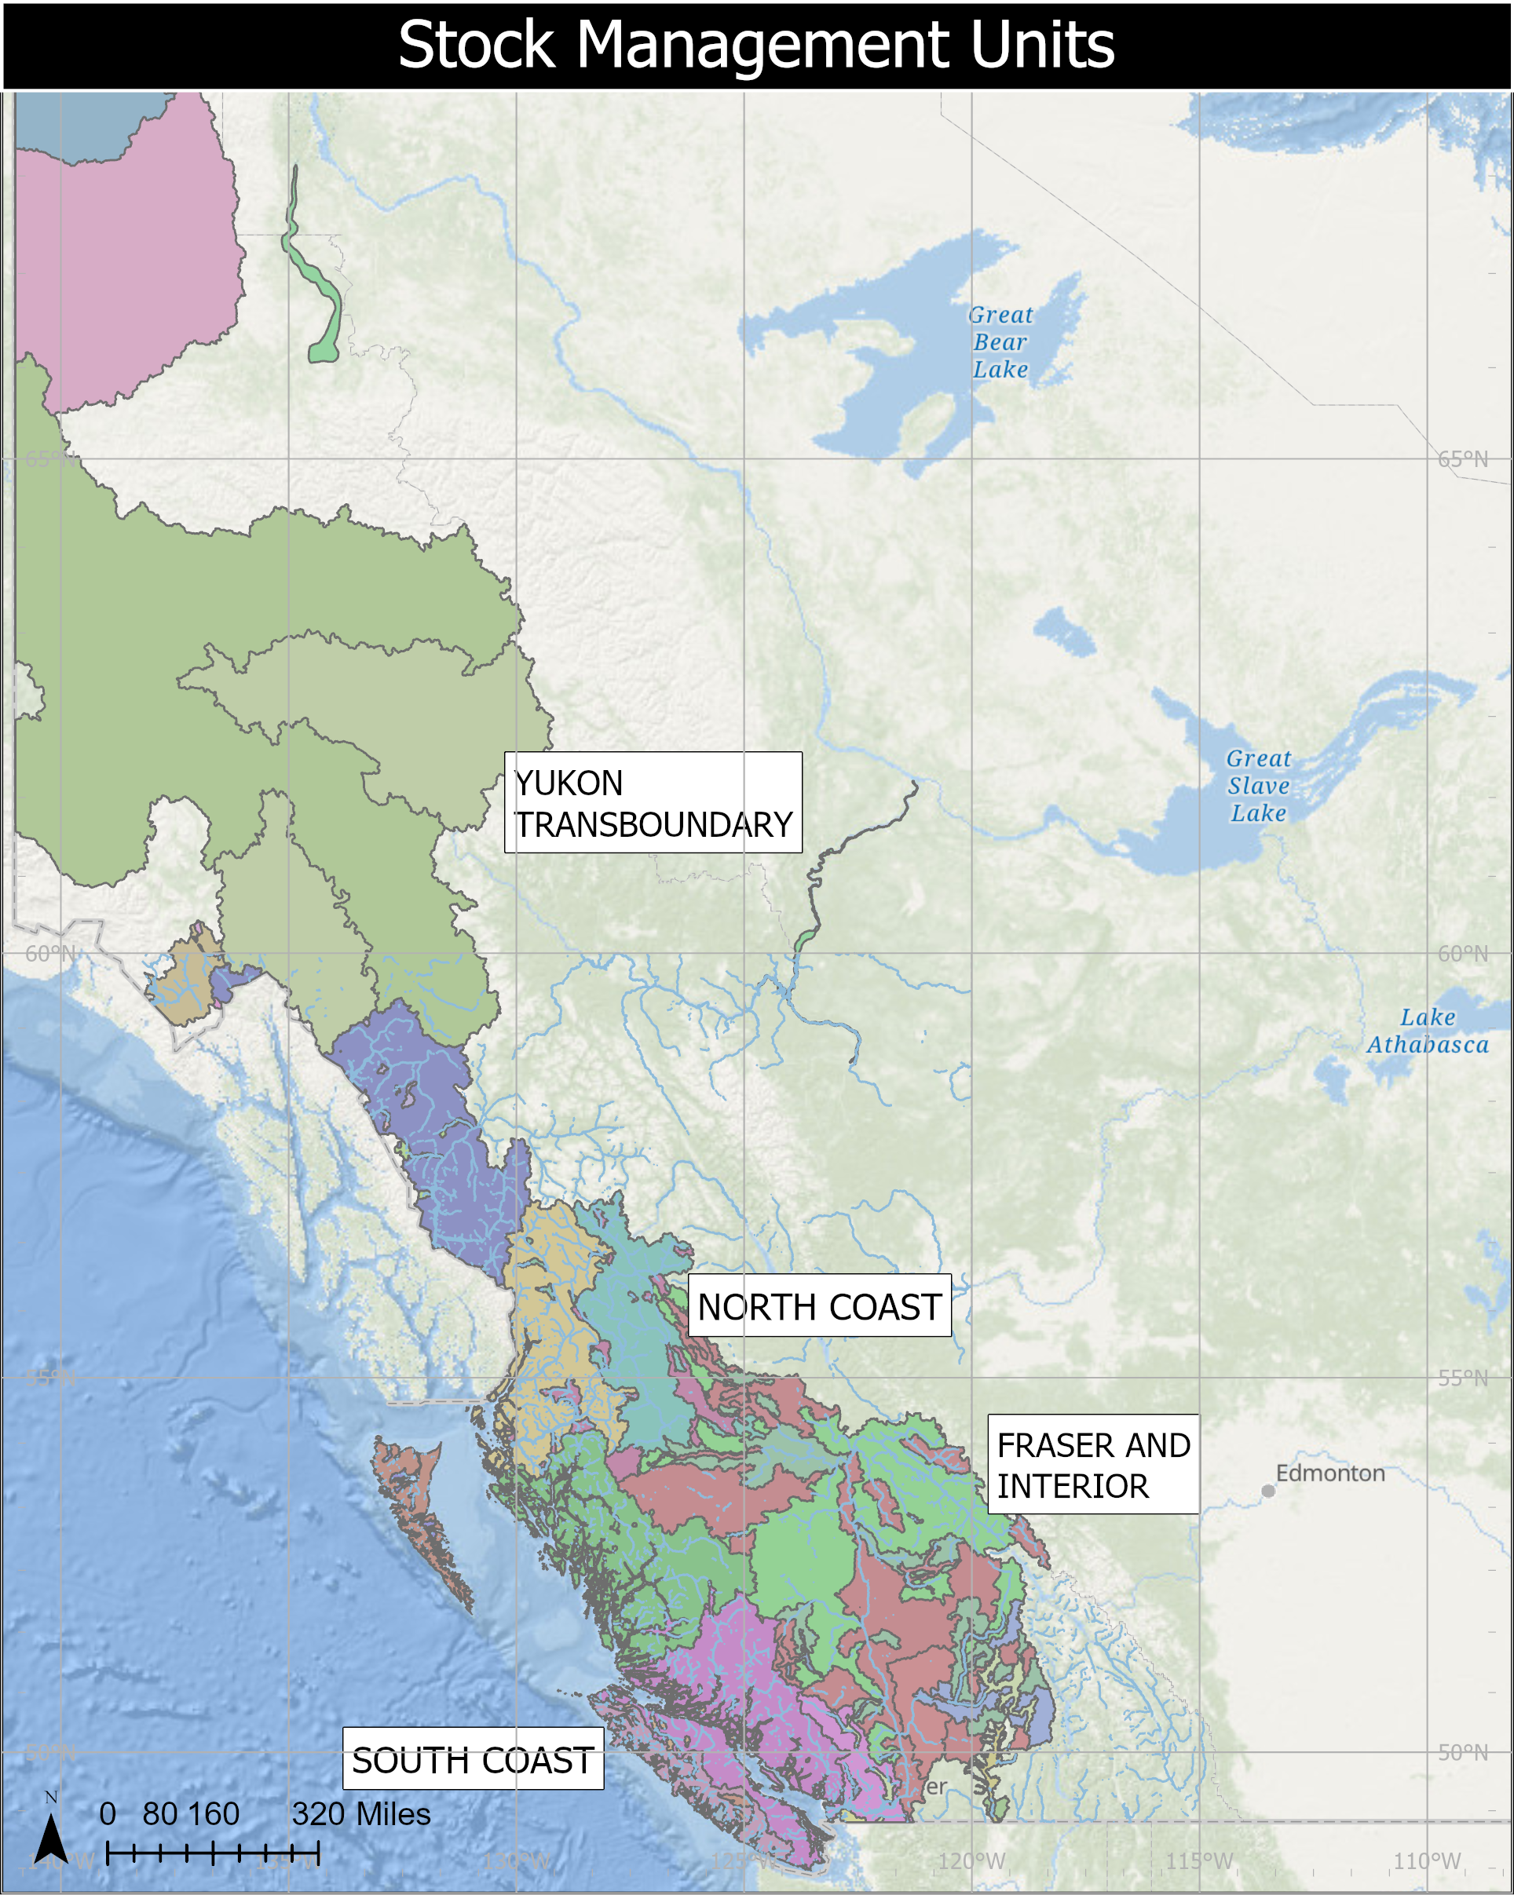
INTRODUCTION
Stock Management Units
What is an SMU?
A group of one or more Conservation Units (CUs) managed together
Harvest rules usually apply to the aggregate
Why use SMUs?
Practical grouping of CUs for harvest planning and reporting
Basis for Integrated Fisheries Management Plans (IFMPs)
Important Notes
CU-level diversity still considered
Precautionary Approach often applied within SMUs
Notes:
Need to update map. Maybe colour by Area. Change projection.

Slide 6
INTRODUCTION
Biological and Management References
Biological benchmarks and limit references points
The SMU or CU is assessed against specified limits and targets (defined by the Wild Salmon Policy and Precautionary Approach)
Pre-defined harvest strategies are in place that define the actions required to meet targets and avoid limits.
Current gap
Many stocks lack defined references
Work is ongoing to develop methods and complete analyses to define these references

Slide 7
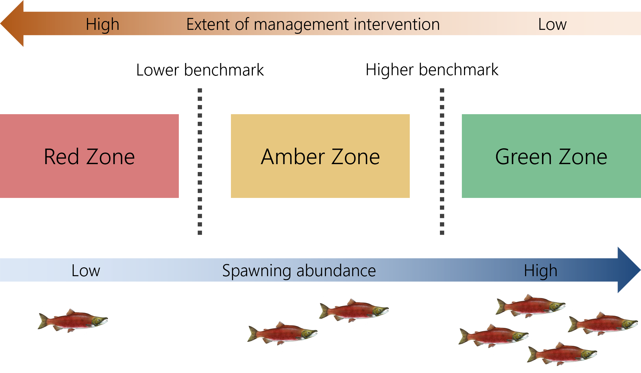
INTRODUCTION
Wild Salmon Policy Benchmarks
CU-level assessment under WSP
CUs are assessed against biological benchmarks
Benchmarks indicate significant changes in production status
Zones and management response
Red: Low abundance ➔ high intervention
Amber: Moderate abundance ➔ caution
Green: High abundance ➔ low intervention
Benchmarks and zones under the Wild Salmon Policy (DFO, 2005)
Notes:
The lower biological benchmark allows for substantial buffer between it and the level of abundance at which the stock would be considered at risk of extinction
The higher biological benchmark delineates the ‘amber’ from ‘green’ WSP status zone

Slide 8
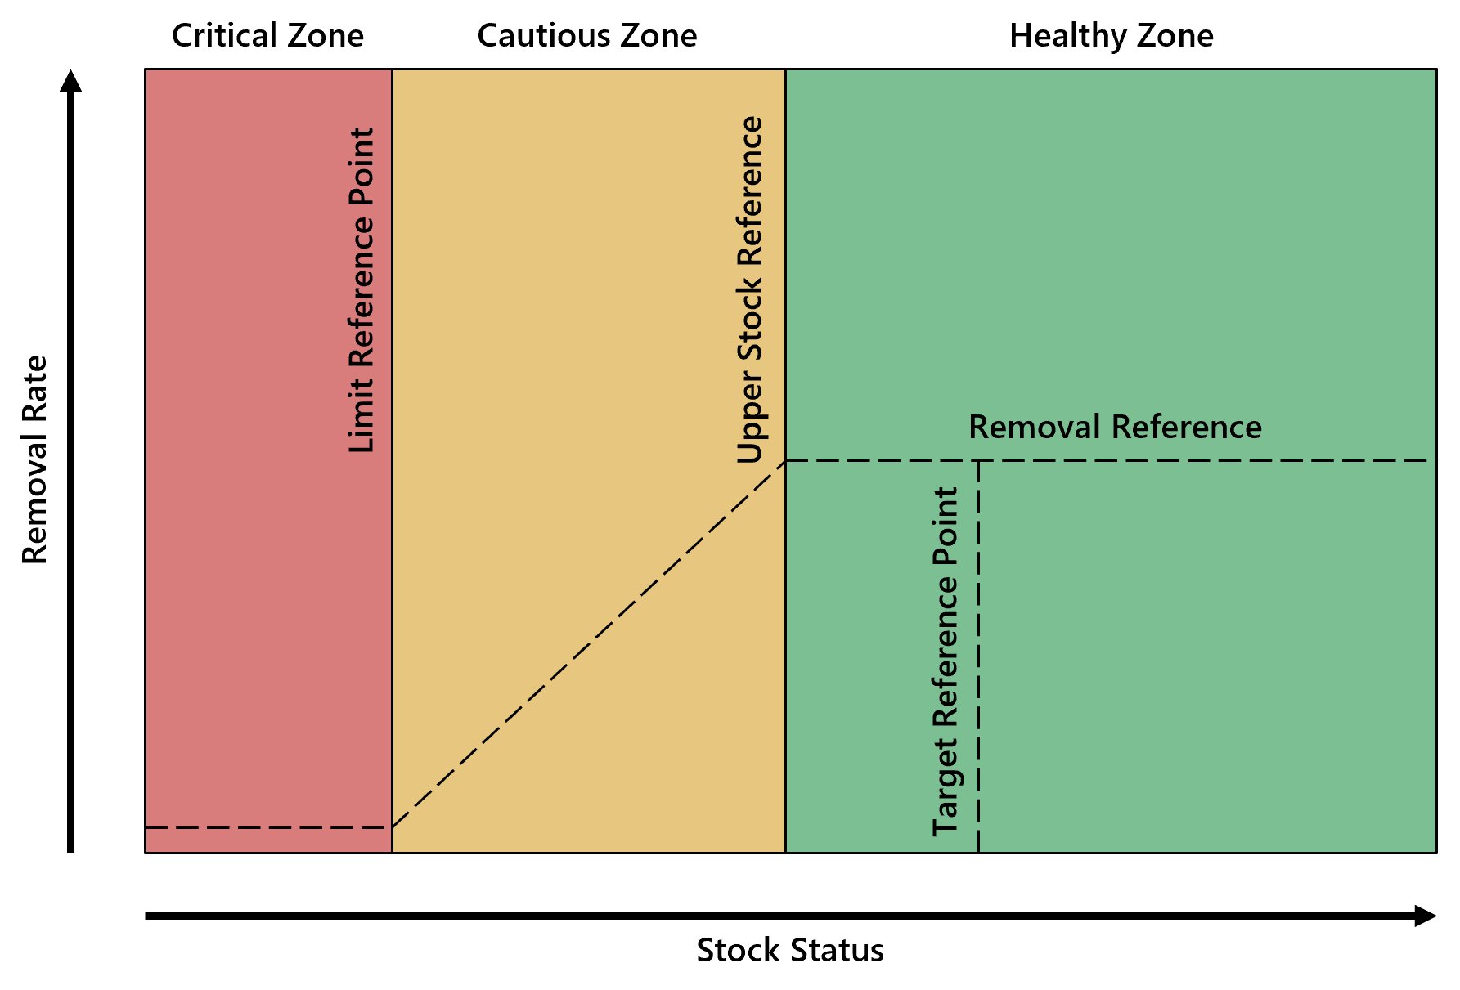
INTRODUCTION
Precautionary Approach
For SMUs: harvest decisions use limit reference points
Limit reference point (LRP) = critical harvest threshold
Below LRP ➔ major stock and ecosystem risk
Methods for defining LRPs vary by data availability
DFO’s precautionary principal

Slide 9
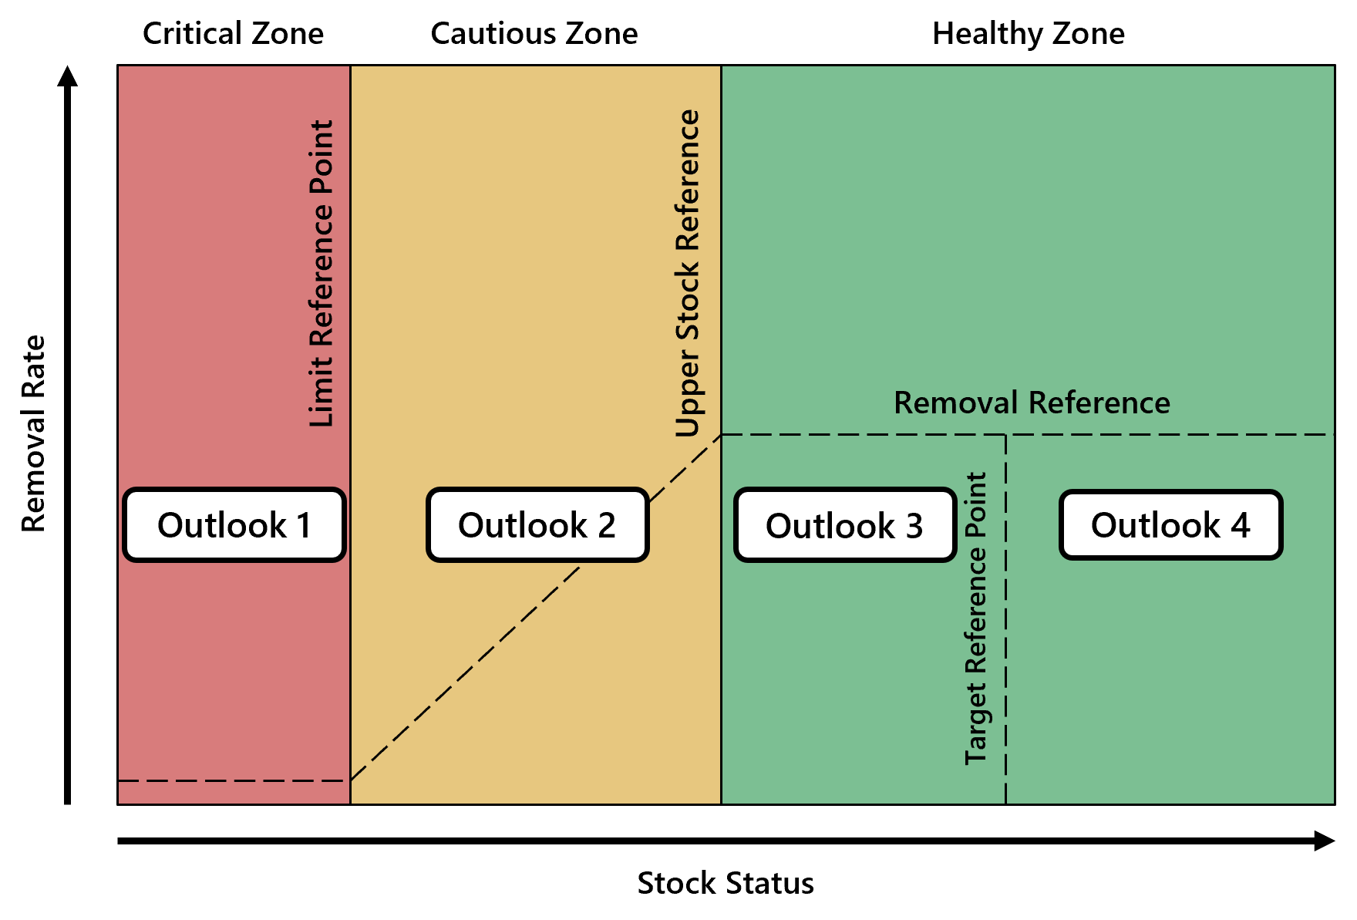
INTRODUCTION
Outlook Categories: Combining Approaches
Outlook Category | CUs or SMUs with references |  |  | Data-Limited CUs or SMUs
 | Wild Salmon Policy (CU Level) | Precautionary Approach (SMU Level) |  | Category Definition | Expected spawning abundance (percentile)
1 | Red Zone | Critical Zone |  | Well below average | <25
2 | Amber Zone | Cautious Zone |  | Below average | 25–40
3 | Green Zone | Healthy Zone |  | Near average | 40–60
4 | Green Zone | Healthy Zone |  | Abundant | >60
Data Deficient | - | - |  | Insufficient information | Unknown

Slide 10
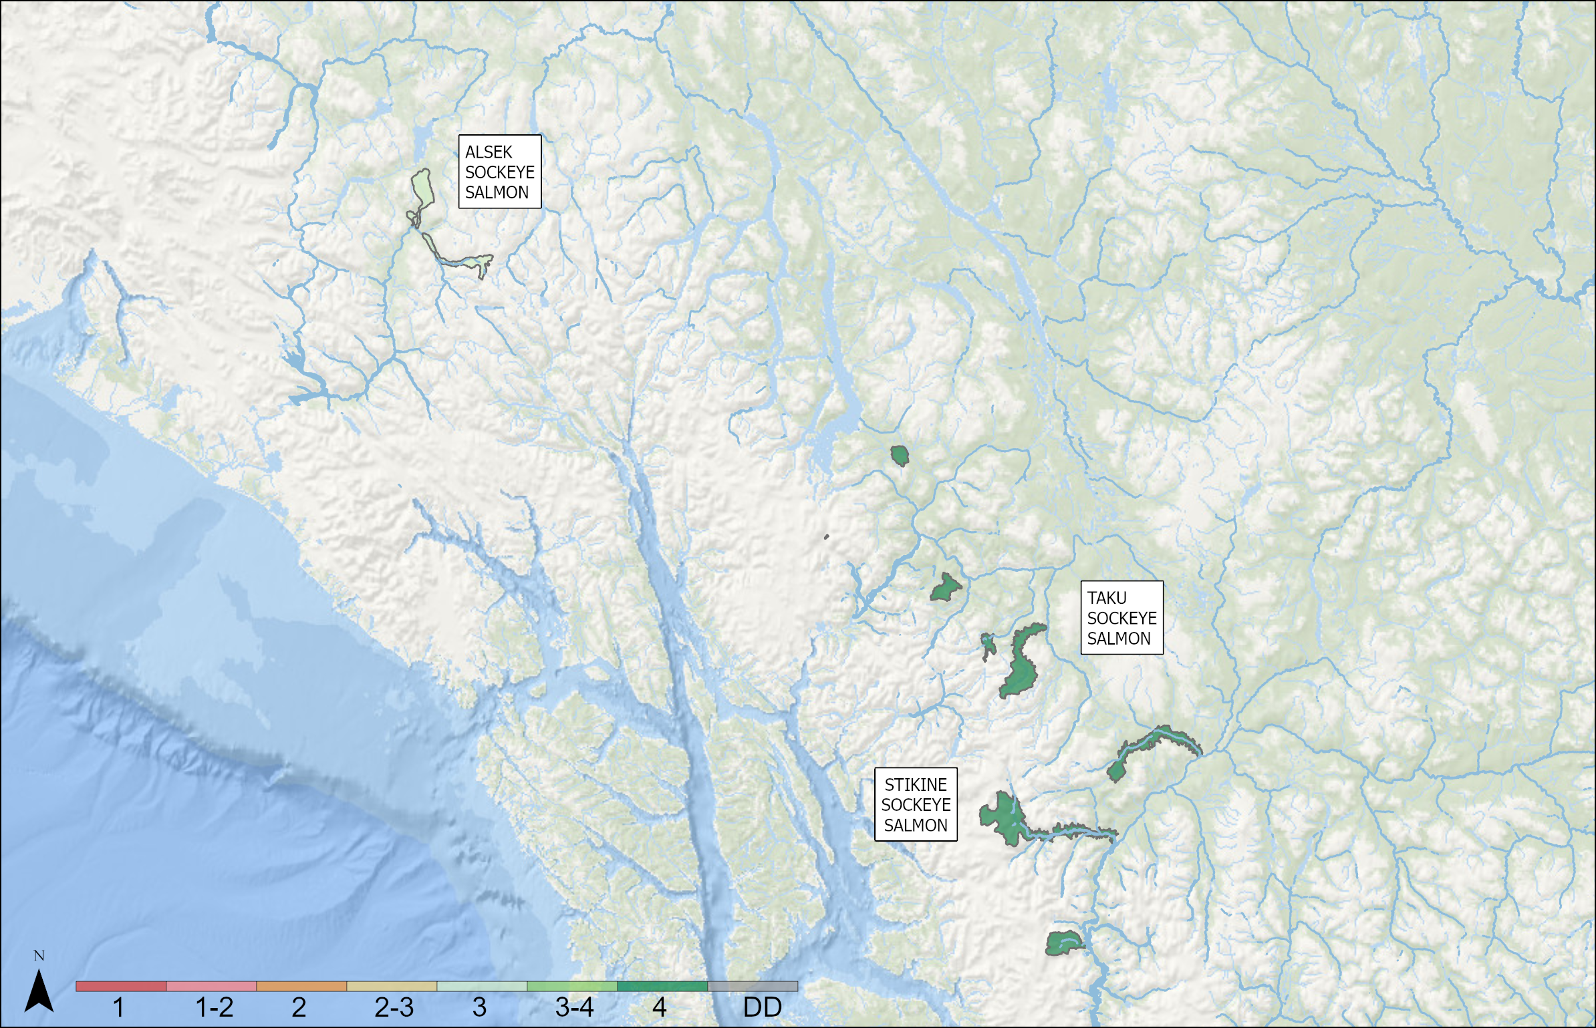
OUTLOOKS – YUKON TRANSBOUNDARY
Yukon Transboundary Sockeye
SMU | Outlook
STIKINE SOCKEYE SALMON | 4
TAKU SOCKEYE SALMON | 4
ALSEK SOCKEYE SALMON | 3
Notes:
STIKINE SOCKEYE SALMON: 2026 outlook will meet escapement requirements and provide for harvest opportunities
TAKU SOCKEYE SALMON: Based on stock-recruitment data, we anticipate the 2026 run will be near the 10 year average of 170,000 and well over the management objective of 58,000. This is an aggregate stock of lake and river type 4 and 5 year olds.
ALSEK SOCKEYE SALMON: This aggregate stock is dominated by lake and river type age 5 fish. Based on brood year escapements that were above average and stock-recruitment relations from historical records, an average run exceeding the upper end of the escapement goal range is expected.

Slide 11
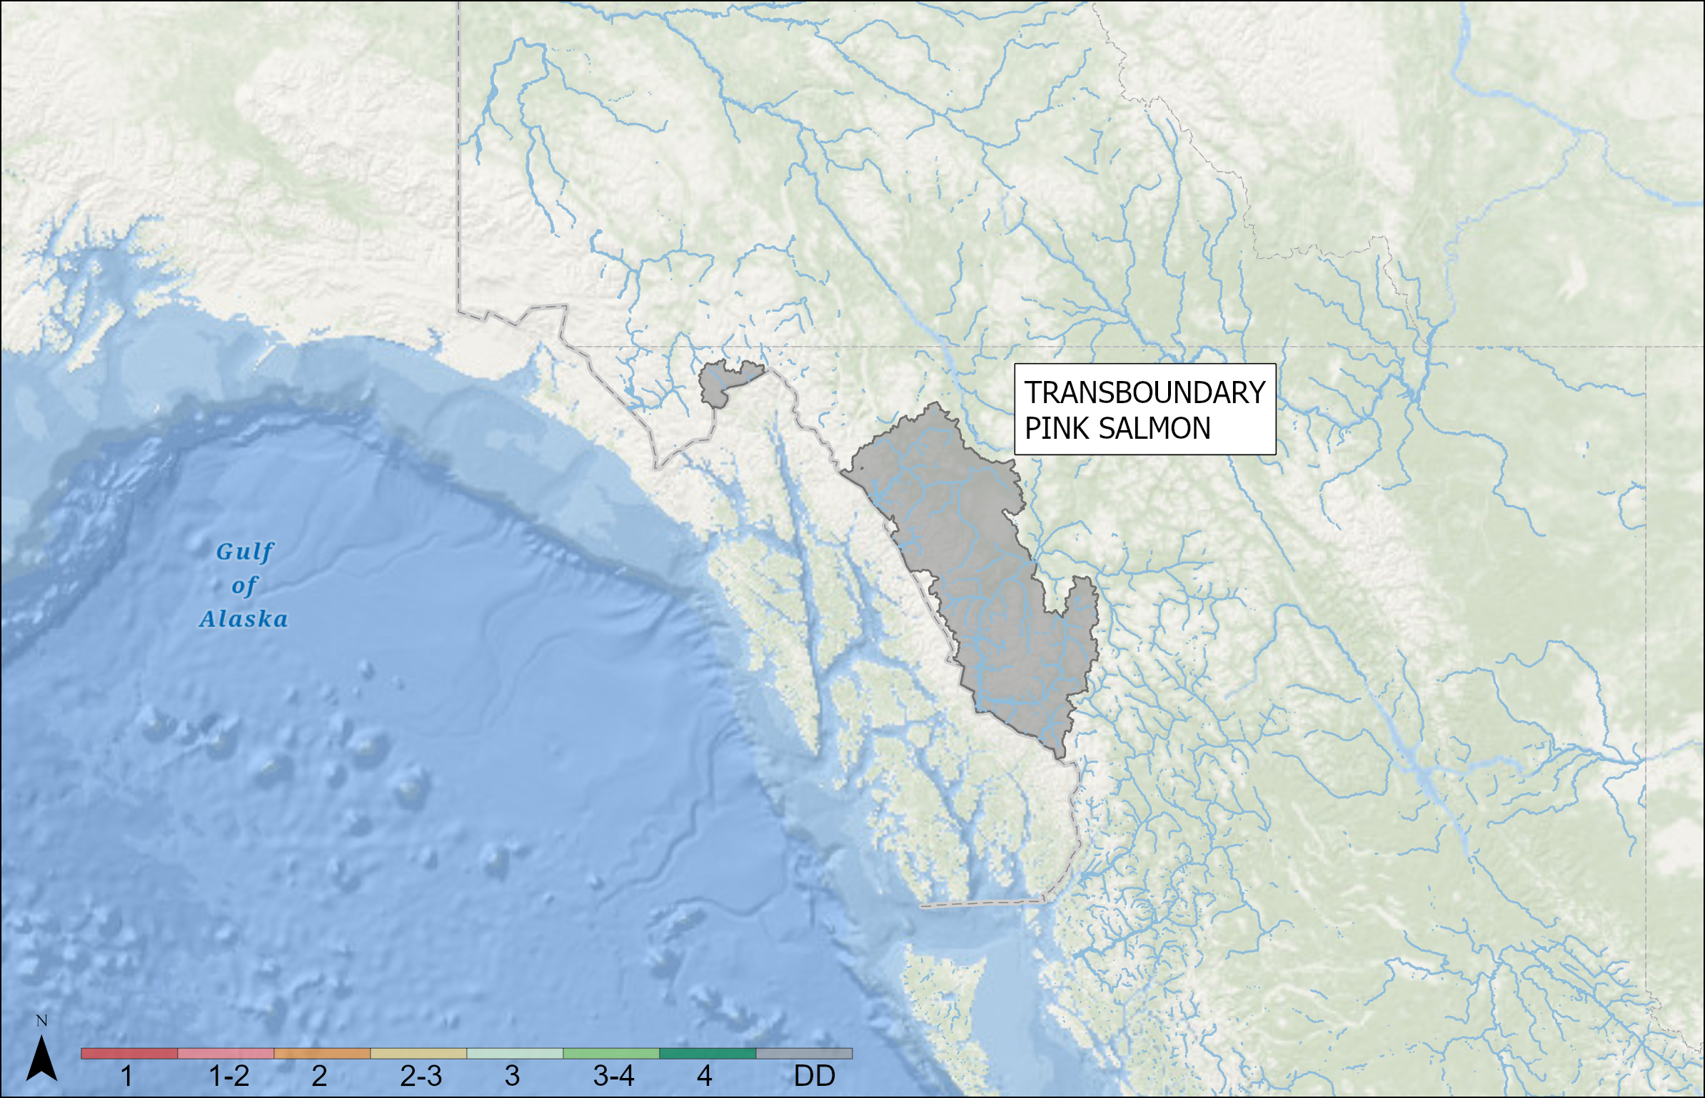
OUTLOOKS – YUKON TRANSBOUNDARY
Yukon Transboundary Pink
SMU | Outlook
TRANSBOUNDARY PINK SALMON | Data Deficient
Notes:
TRANSBOUNDARY PINK SALMON: data deficient

Slide 12
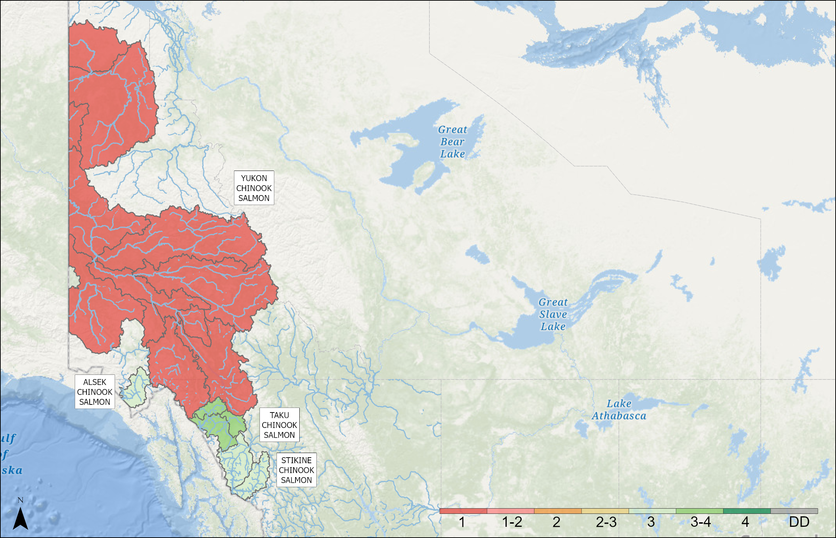
OUTLOOKS – YUKON TRANSBOUNDARY
Yukon Transboundary Chinook
SMU | Outlook | Forecast
ALSEK CHINOOK SALMON | 3
STIKINE CHINOOK SALMON | 3 | 16,704
TAKU CHINOOK SALMON | 3 to 4 | 33,200 (23,000–43,300)
YUKON CHINOOK SALMON | 1
PORCUPINE CHINOOK SALMON | 1
Notes:
ALSEK CHINOOK SALMON: Alsek CU (CK-67) includes 5 rivers (Alsek, Blanchard, Goat, Klukshu and Takhanne). Alsek Chinook are stream type dominated by 5 year olds. Based on brood year escapement being above average and near the MSY target range and recent sibling survival data, an average run within the escapement goal range is expected.
STIKINE CHINOOK SALMON: An aggregate including 2 CUs. The 2026 run is forecast to be slightly above the 10-year average of 12,100 fish and within the escapement goal range of 14,000 - 28,000. Stikine Chinook are stream type, dominated by 5 and 6 year olds
TAKU CHINOOK SALMON: The aggregate Taku River terminal return of large (>659mm MEF) Chinook salmon for 2026 is forecasted to be 33,200 (95% prediction intervals: 23000-43300). This is based on a sibling expansion method. As usual, the return will be dominated by 5 year old fish. This forecast is well above the recent ten year average return.
YUKON CHINOOK SALMON: The forecast model used for the Yukon Chinook SMU is informative to their entry into the Yukon River and does not currently account for en route mortality during their 2000 km migration through Alaska, in advance of their entry into Canada and the Yukon Chinook SMU. In recent years (2019-2023), Chinook en route mortality prior to reaching the SMU was substantial (~30-50%). However, in 2024 and 2025, the estimated mortality has dropped and if similar conditions continue into 2026, we anticipate the forecast model to provide a good indication of return to the SMU. The Interim Management Escapement Goal for this SMU was 42,500 to 55,000 until 2024 when a rebuilding target of 71,000 was approved for seven years, in addition to a closure to all targeted in river Chinook fishing in the Alaska and Canada. These actions were implemented along with several others which are intended to support the preservation and rebuilding of Yukon River Chinook Salmon. Estimates of Canadian-origin Yukon River Chinook Salmon (Yukon Chinook SMU) in the 1980's and 90's routinely exceeded 150,000, but since 2000 there has been a relatively steady decline in annual abundance with the lowest five years on record from 2021 - 2025 (5 year average of 22,000). The 2026 forecast for Yukon Chinook SMU will be available in the coming weeks and it is anticipated to be similar to returns seen in 2024 and 2025, ~25,000.
PORCUPINE CHINOOK SALMON: There is no forecast available for this SMU and it does not have an escapement goal associated with its management. The Porcupine Chinook SMU contains three CUs, one of which is data deficient. This CU (Salmon Fork CU) may only contain a very small spawning population, if at all. Assessment on the Porcupine River captures migrating fish to the other two CUs. This project started ~10 years ago, and with continued operation, we are hopefully of developing a forecast for this SMU. However, passage at this assessment site has dropped from an average of 4,000 (2014-2019) to 400 (2021-2025).

Slide 13
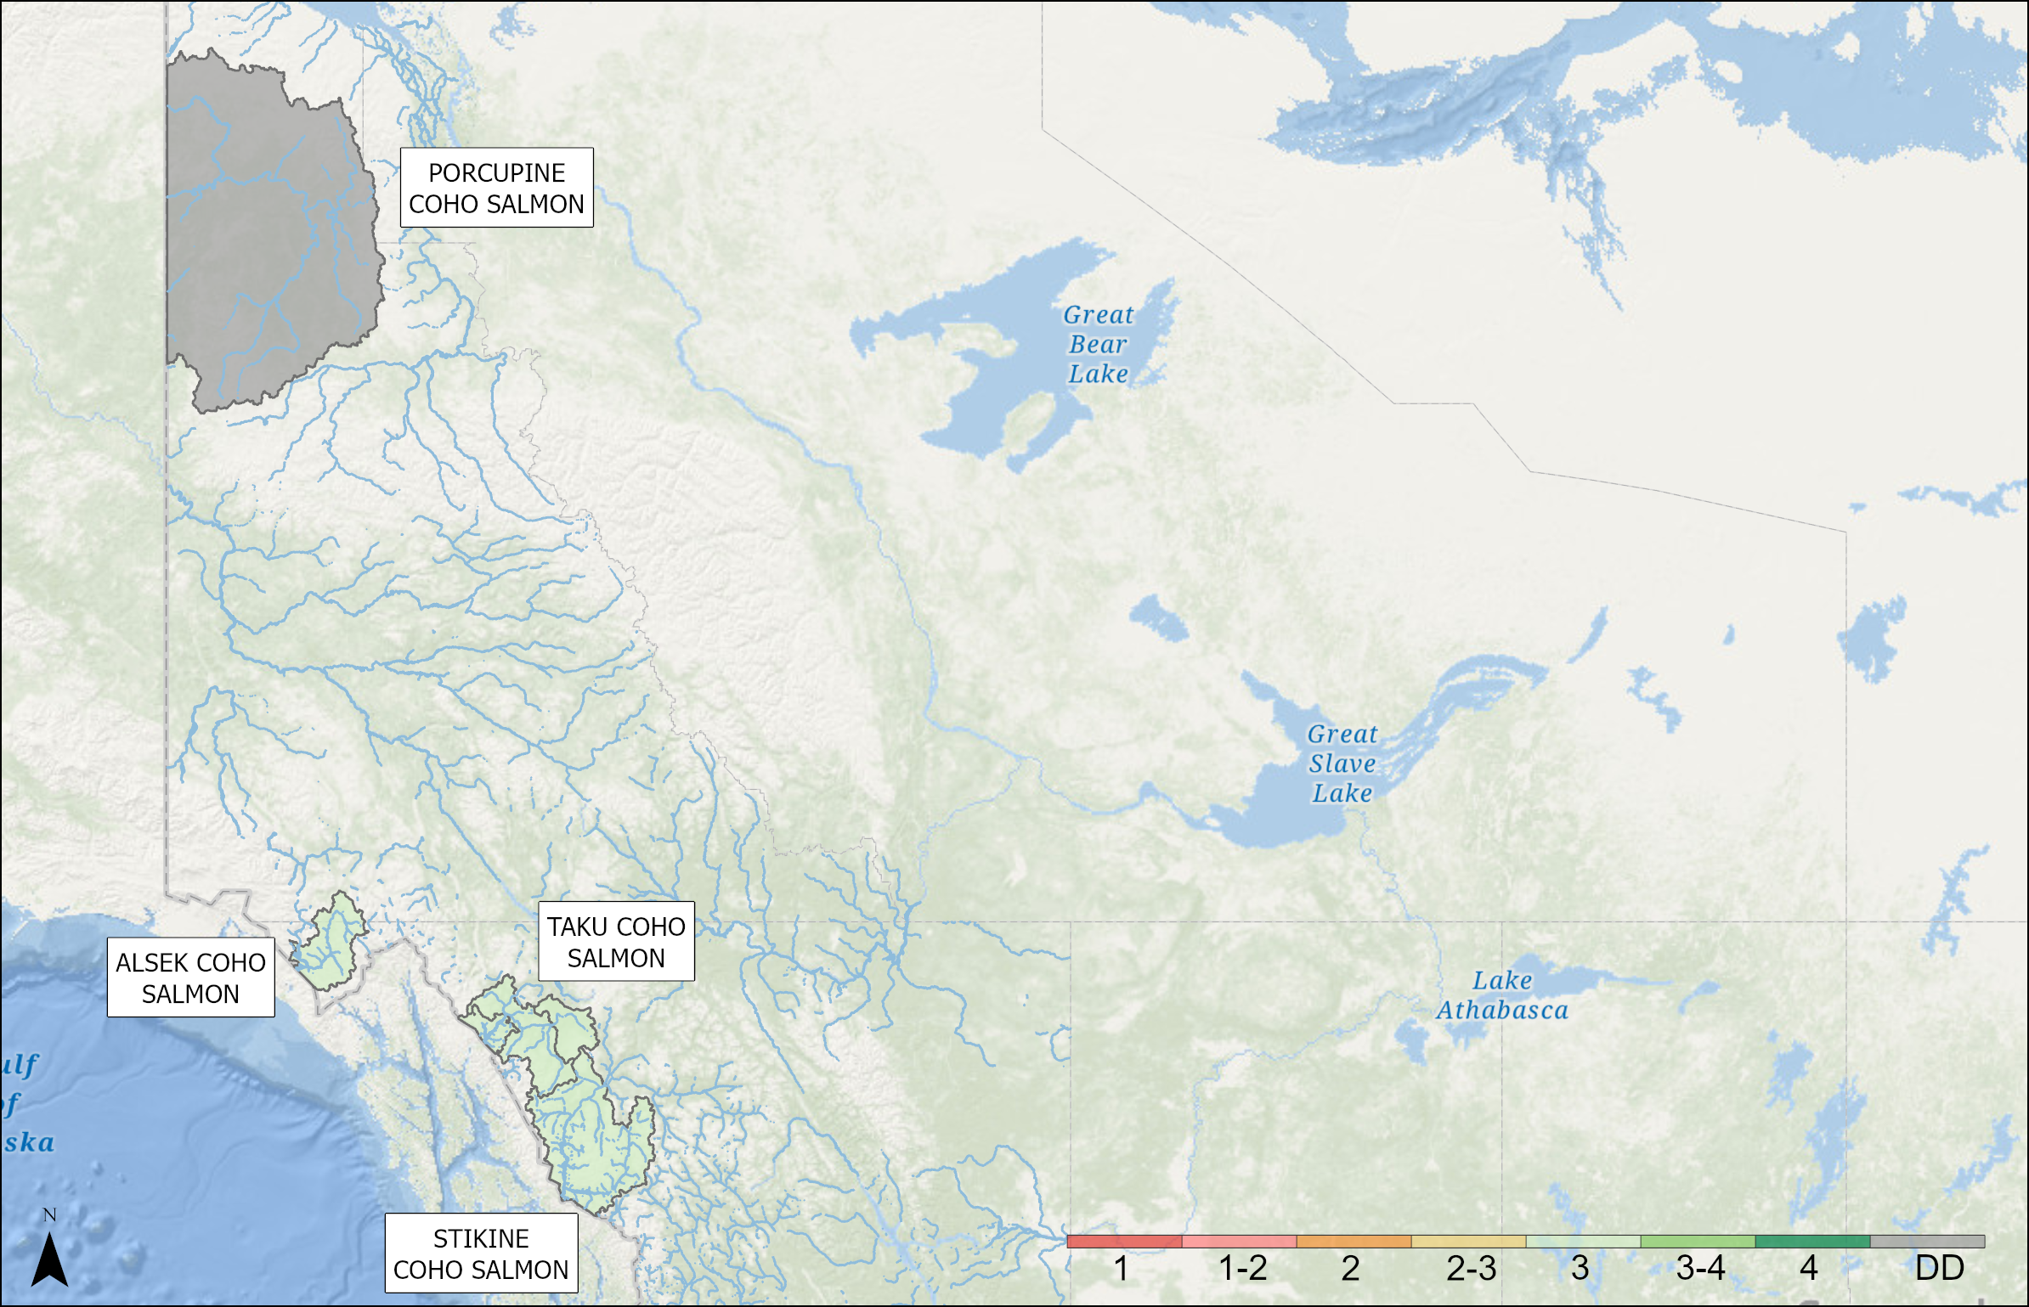
OUTLOOKS – YUKON TRANSBOUNDARY
Yukon Transboundary Coho
SMU | Outlook
ALSEK COHO SALMON | 3
PORCUPINE COHO SALMON | Data Deficient
STIKINE COHO SALMON | 3
TAKU COHO SALMON | 3
Notes:
ALSEK COHO SALMON: Alsek CU (CO-45). Only a partial weir count is carried out. Run is dominated by 4 year olds. Brood year counts were below average.
PORCUPINE COHO SALMON: There is no forecast or data to inform this SMU.
STIKINE COHO SALMON: 2026 preliminary outlooks suggest escapement requirements will be achieved and a surplus for harvest opportunities will be provided
TAKU COHO SALMON: Based on preliminary smolt abundance in 2025 combined with recent smolt-to-adult survival rates, an average run above the management target of 70,000 is expected for 2026. Run is an even split of 3 and 4 year olds.

Slide 14
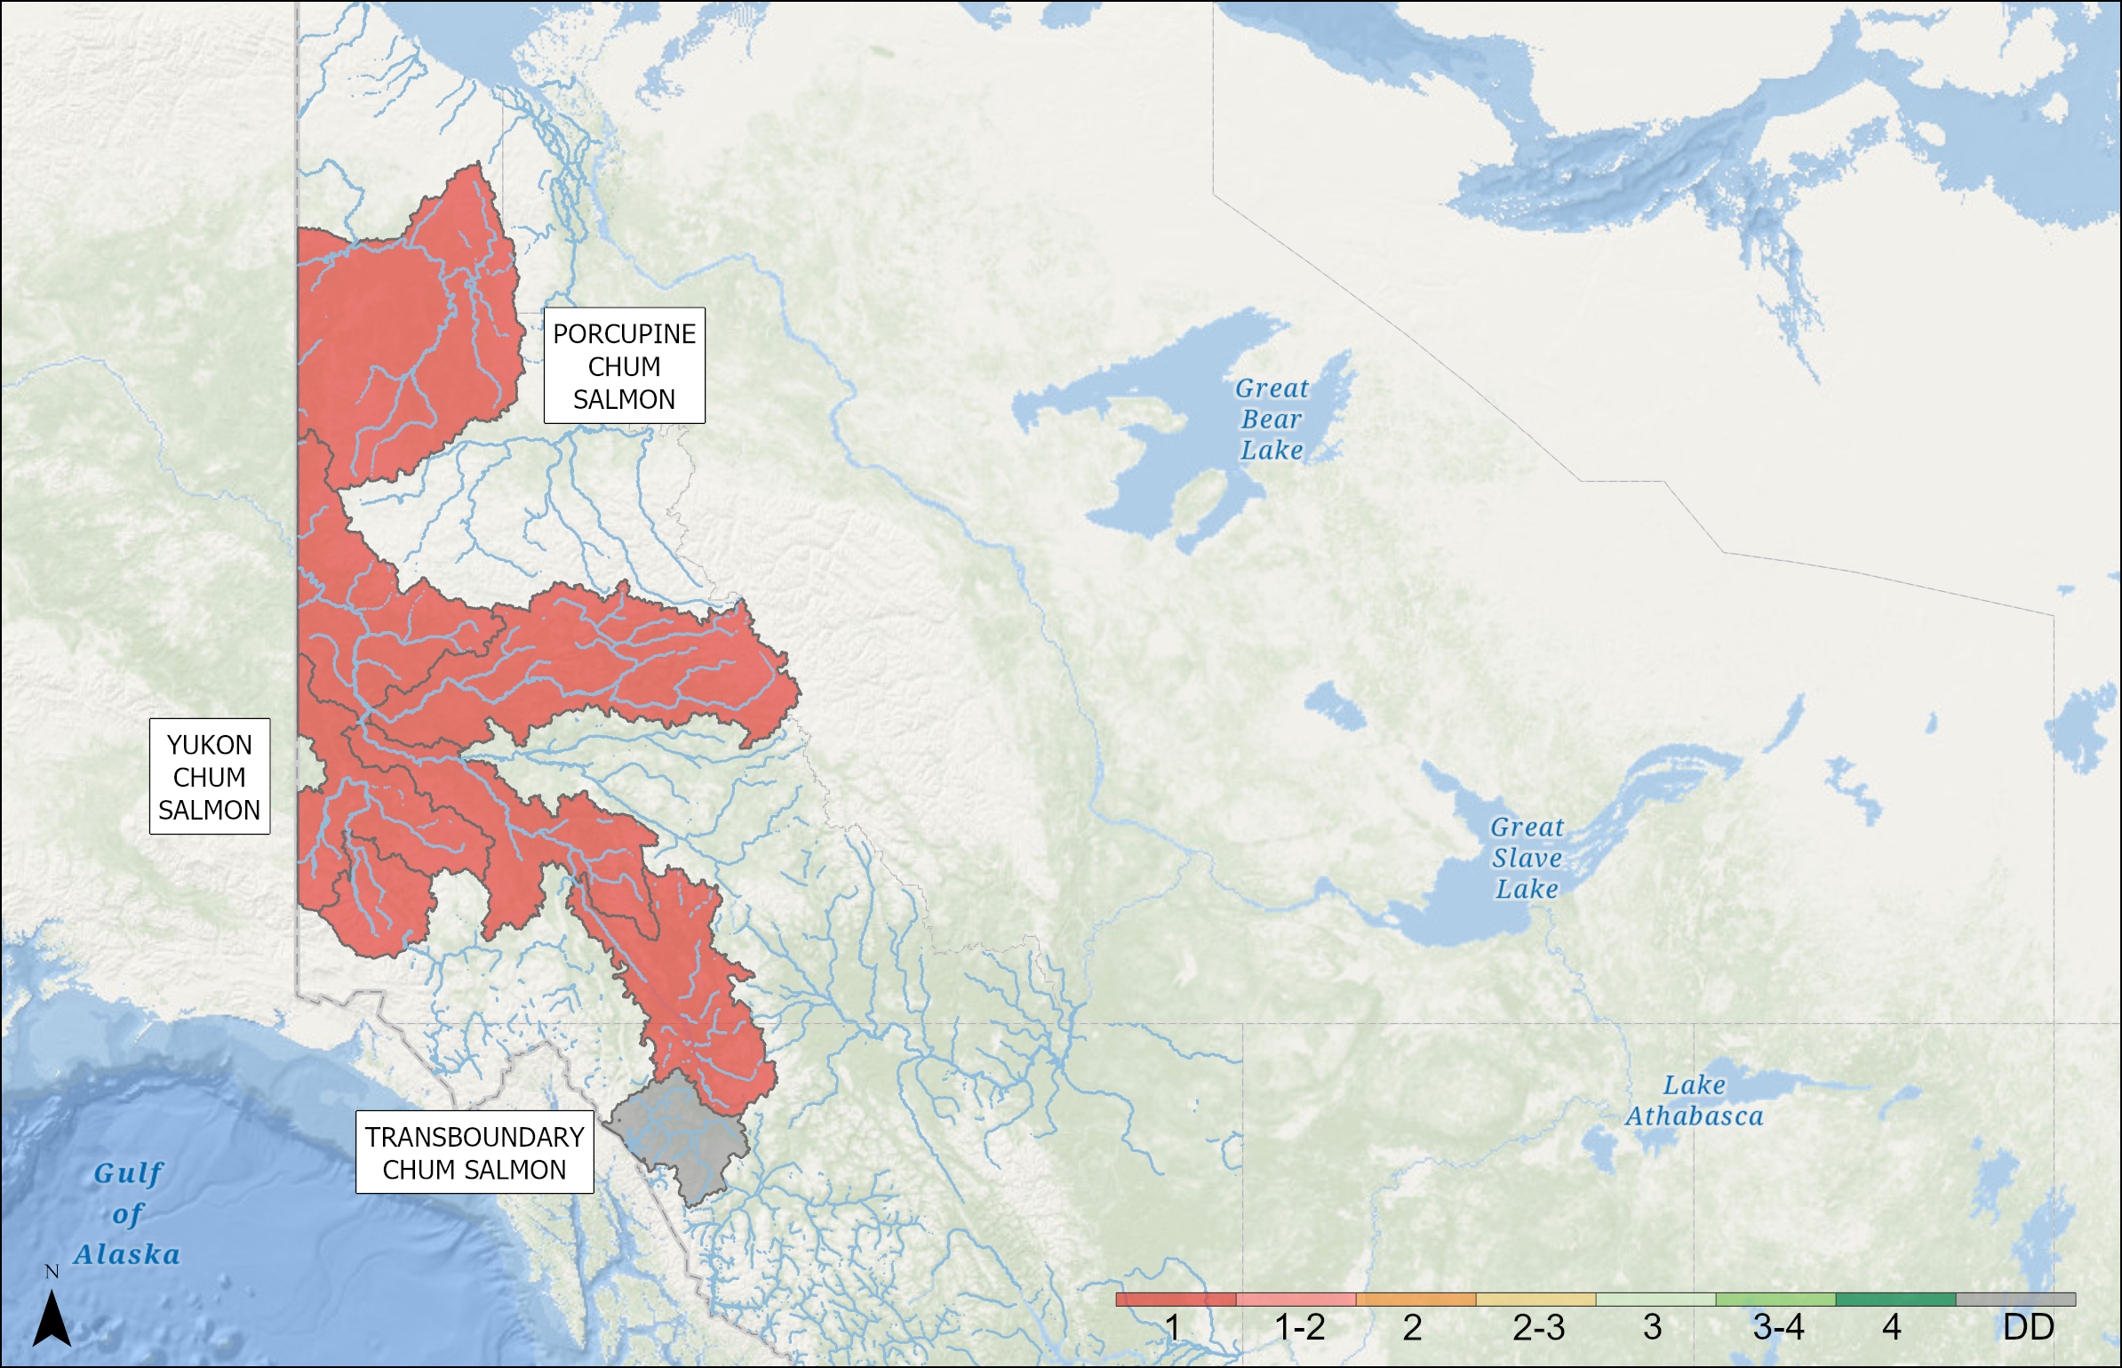
OUTLOOKS – YUKON TRANSBOUNDARY
Yukon Transboundary Chum
SMU | Outlook
PORCUPINE CHUM SALMON | 1
TRANSBOUNDARY CHUM SALMON | Data Deficient
YUKON CHUM SALMON | 1
Notes:
PORCUPINE CHUM SALMON: The Porcupine Chum Salmon SMU contains a single CU. The spawning escapement to this SMU is monitored at two sites, a sonar site ~50km upstream of the Canada/US border (operational since 2011) and a weir/sonar site immediately downstream of their predominant spawning habitat in the SMU (operational since 1971). The weir is installed on the Fishing Branch River, a tributary of the upper Porcupine River, and management only includes an escapement goal for this stock, 22,000 - 49,000 fish. This escapement goal is currently under review, and recommendation is expected in 2027. The estimated return of Porcupine Chum Salmon in 2025 was 11,918, including the Fishing Branch River component of 7,858. Since 2011, the estimated return to this SMU has averaged 25,000 and the long term return to Fishing Branch River has averaged 43,000, so the 2025 return is well below average. The 2026 forecast is not yet known, and will for formally accepted and available in March.
TRANSBOUNDARY CHUM SALMON: Data deficient.
YUKON CHUM SALMON: The spawning escapement of Canadian-origin Yukon River mainstem Chum salmon (Yukon Chum Salmon SMU) in 2025 was the second lowest on record, at 19,574 - only exceeding the record low return in 2024. The run is dominated by four year old fish. While chum productivity across the Yukon River has decreased dramatically since 2020, a prominent spawning population in the SMU has experience a potential catastrophic environmental shift that may have resulted in a large reduction in spawning habitat. The current mainstem spawning escapement goal endorsed by the Yukon River Panel is 70,000 – 104,000 Chum salmon, which has been met every year between 2002 - 2019. The escapement goal has not been met since 2020 and averages 21,000 between 2020 - 2025. The escapement goal is currently under review, with an updated recommendation expected in 2027. The 2026 forecast of Yukon Chum Salmon SMU is not yet available. This forecast is typically approved and available in March of each year. Coming off record low age 4 brood year returns, the 2025 return showed signs of improving productivity. If this continues into 2026, we may start to see subtle improvements in the return, though it is anticipated to remain very low compared to pre-2020 returns, and likely within a similar range as recent years' returns.

Slide 15
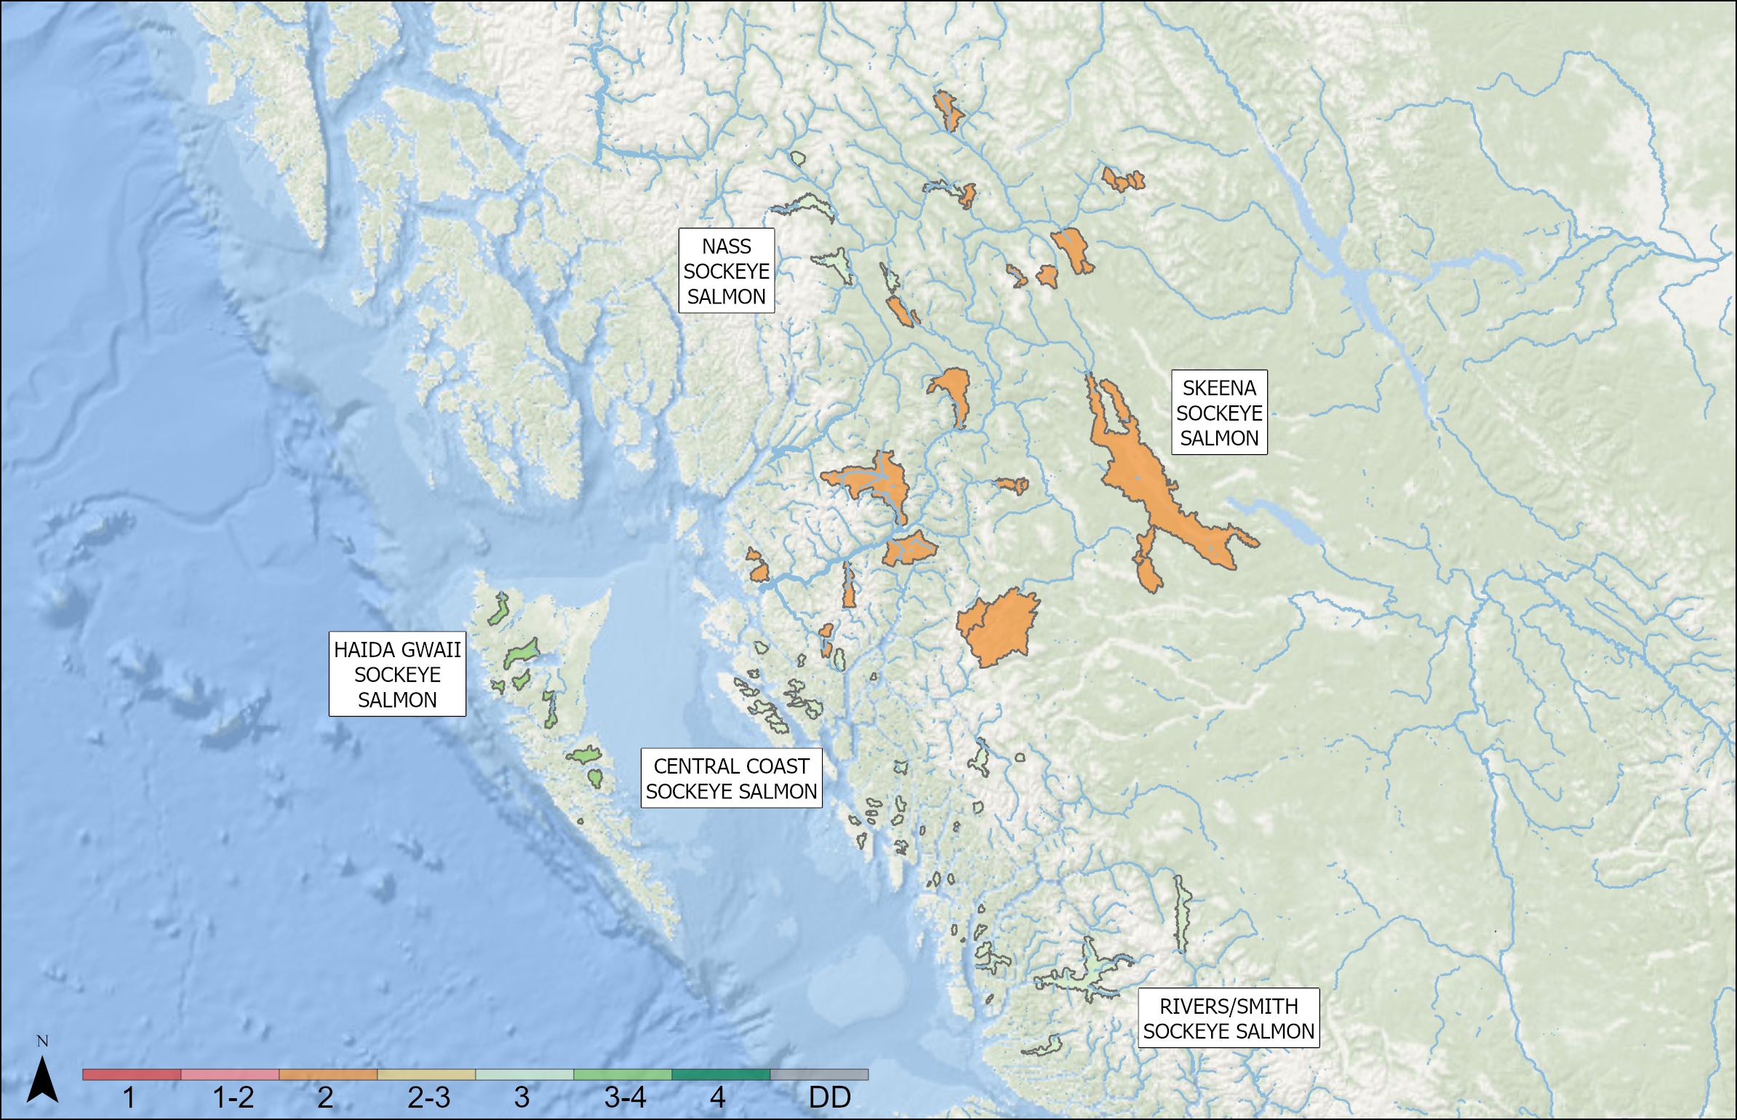
OUTLOOKS – NORTH COAST
North Coast Sockeye
SMU | Outlook | Forecast
NASS SOCKEYE SALMON | 3 | 243,000–1,066,000
SKEENA SOCKEYE SALMON | 2 | 729,000–3,288,000
HAIDA GWAII SOCKEYE SALMON | 3 to 4
CENTRAL COAST SOCKEYE SALMON | 3
RIVERS/SMITH SOCKEYE SALMON | 3
Notes:
NASS SOCKEYE SALMON: N/A
SKEENA SOCKEYE SALMON: Lower than average returns expected for aggregate stock based on sibling forecast model. Very poor return of age-3's in 2025 predicts low return of age-4's for 2026.
HAIDA GWAII SOCKEYE SALMON: Includes CUs in Area 1 and 2. Escapements for systems that were inspected ranged from average to higher than average, good returns for the largest systems within this DU.
CENTRAL COAST SOCKEYE SALMON: Information received for Atnarko sockeye (DFO) and several smaller Area 8 systems (Koeye, Namu, Kasjusdis, Hooknose). Data quality varies among streams. Returns for 2025 ranged from average to higher than (recent) average for most of these systems.
RIVERS/SMITH SOCKEYE SALMON: As of December 18 2025, 2025 escapement estimates are not available for either Rivers or Smith Inlet sockeye. Anecdotal reports suggest strong returns for Rivers Inlet sockeye relative to 2000-current time period.

Slide 16
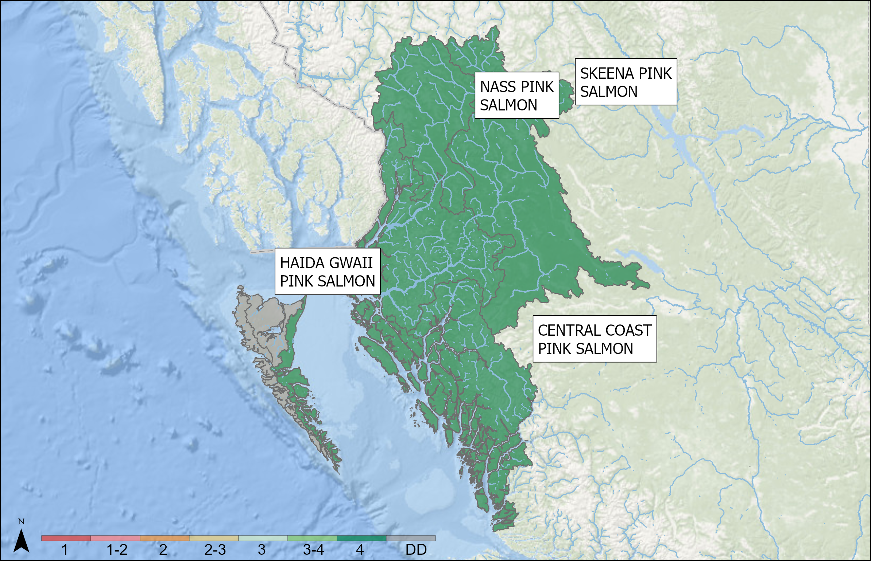
OUTLOOKS – NORTH COAST
North Coast Pink
SMU | Resolution | CU | Outlook
NASS PINK SALMON | SMU | - | 4
SKEENA PINK SALMON | SMU | - | 4
HAIDA GWAII PINK SALMON | CU (singular) | EAST HAIDA GWAII | 4
HAIDA GWAII PINK SALMON | CU (aggregate) | NORTH HAIDA GWAII, WEST HAIDA GWAII | Data Deficient
CENTRAL COAST PINK SALMON | CU (aggregate) | HECATE LOWLANDS, HECATE STRAIT-FJORDS | 4
CENTRAL COAST PINK SALMON | Area 9–10 | Homathko-Klinaklini-Smith-Rivers-Bella Coola-Dean | Data Deficient
Notes:
NASS and SKEENA PINK SALMON: Returns expected to be above average
HAIDA GWAII PINK SALMON: Above average returns forecasted for Haida Gwaii East (2E) and data deficient for Haida Gwaii North and West.
CENTRAL COAST PINK SALMON: Area 6,7, and 8 Pink Salmon are forecasted to be abundant. Area 5, 9, and 10 are data deficient,

Slide 17
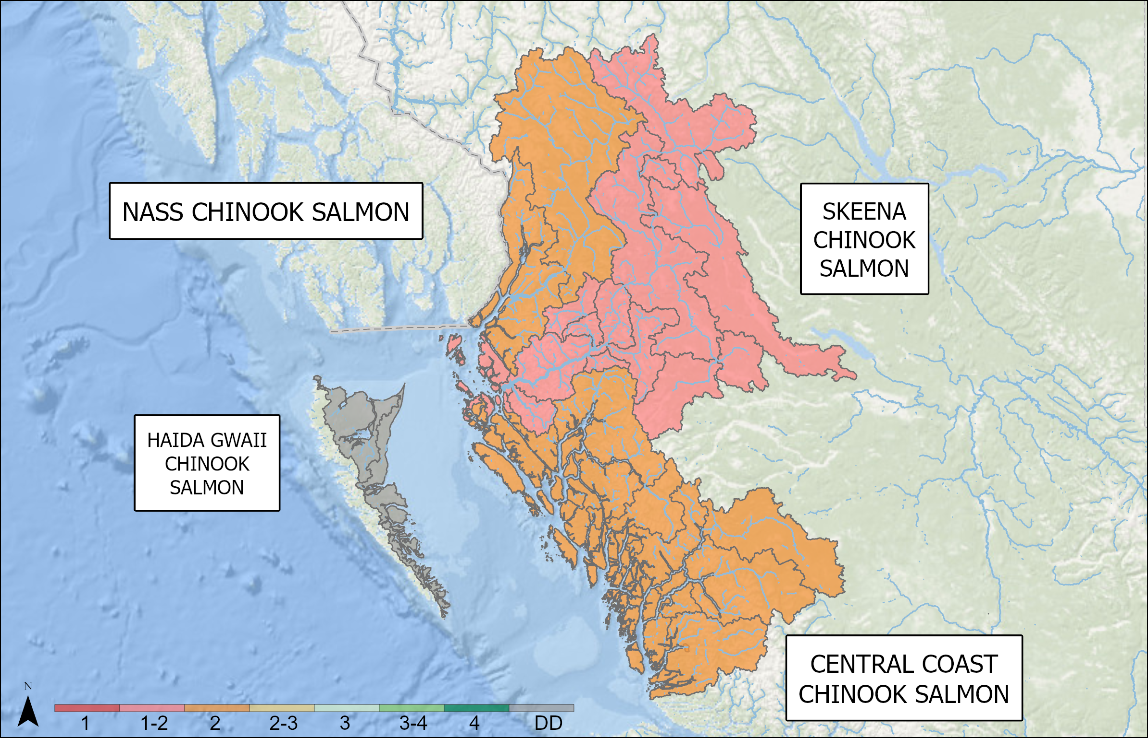
OUTLOOKS – NORTH COAST
North Coast Chinook
SMU | Outlook
NASS CHINOOK SALMON | 2
SKEENA CHINOOK SALMON | 1 to 2
HAIDA GWAII CHINOOK SALMON | Data Deficient
CENTRAL COAST CHINOOK SALMON | 2
Notes:
NASS CHINOOK SALMON: The preliminary 2025 escapement estimate was above the escapement goal of 15,000 Chinook. The escapement goal has only been reached four times in the last fifteen years (2015, 2018, 2022 and 2015).
SKEENA CHINOOK SALMON: The 2025 Kitsumkalum River and Skeena aggregate escapement estimates are not yet available. Below average returns are expected due to low returns in 2019-2022.
HAIDA GWAII CHINOOK SALMON: A multi-species sonar assessment program commenced on the Yakoun in 2021 but Chinook estimates remain uncertain.
CENTRAL COAST CHINOOK SALMON: Area 6: The Kitimat watershed is data deficient. Area 8: A 2025 escapement estimate is not yet available for the Atnarko River. Other rivers in Area 8 are data deficient. Areas 9 and 10: Owikeno tributary, Wannock River and Docee Chinook returns are data deficient. There are multi-species sonar assessments on both the Wannock and Docee rivers but estimates remain uncertain. Recent Chuckwalla and Kilbella rivers returns are below average based on recent trends.

Slide 18
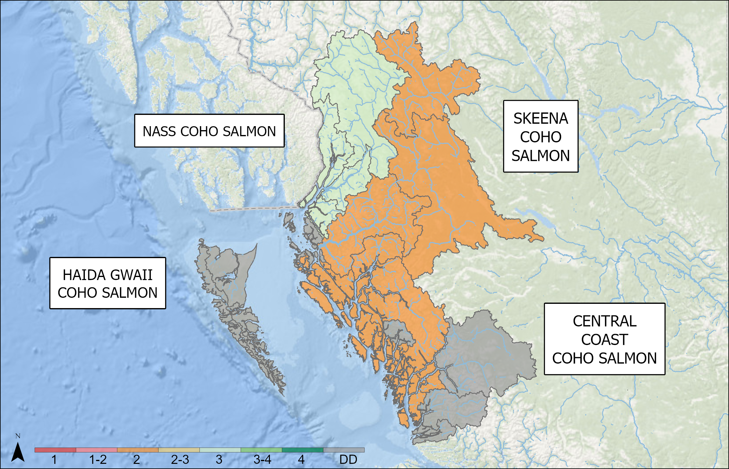
OUTLOOKS – NORTH COAST
North Coast Coho
SMU | Resolution | CU | Outlook
NASS COHO SALMON | SMU | - | 3
SKEENA COHO SALMON | SMU | - | 2
SKEENA COHO SALMON | CU (singular) | SKEENA ESTUARY | Data Deficient
SKEENA COHO SALMON | CU (aggregate) | UPPER SKEENA, LOWER SKEENA, MIDDLE SKEENA | 2
HAIDA GWAII COHO SALMON | SMU | - | Data Deficient
CENTRAL COAST COHO SALMON | PFMA 6 | CENTRAL COAST COHO SALMON | 2
CENTRAL COAST COHO SALMON | PFMAs 7–10 | CENTRAL COAST COHO SALMON | Data Deficient
Notes:
NASS COHO SALMON: For the Nass Coho Salmon aggregate (i.e., Portland Sound-Observatory CU, Lower Nass CU, and Upper Nass CU) we expect a near average return in 2026.
SKEENA COHO SALMON: For the Skeena Coho Salmon aggregate (i.e., Skeena Estuary CU, Lower Skeena CU, Middle Skeena CU and Upper Skeena CU), low returns are expected in 2026.
HAIDA GWAII COHO SALMON: There are limited assessments since 2002.
CENTRAL COAST COHO SALMON: PFMA 6 Coho Salmon are expected to be below average in 2026. CENTRAL COAST COHO SALMON: PFMAs 7-10 are data deficient.

Slide 19
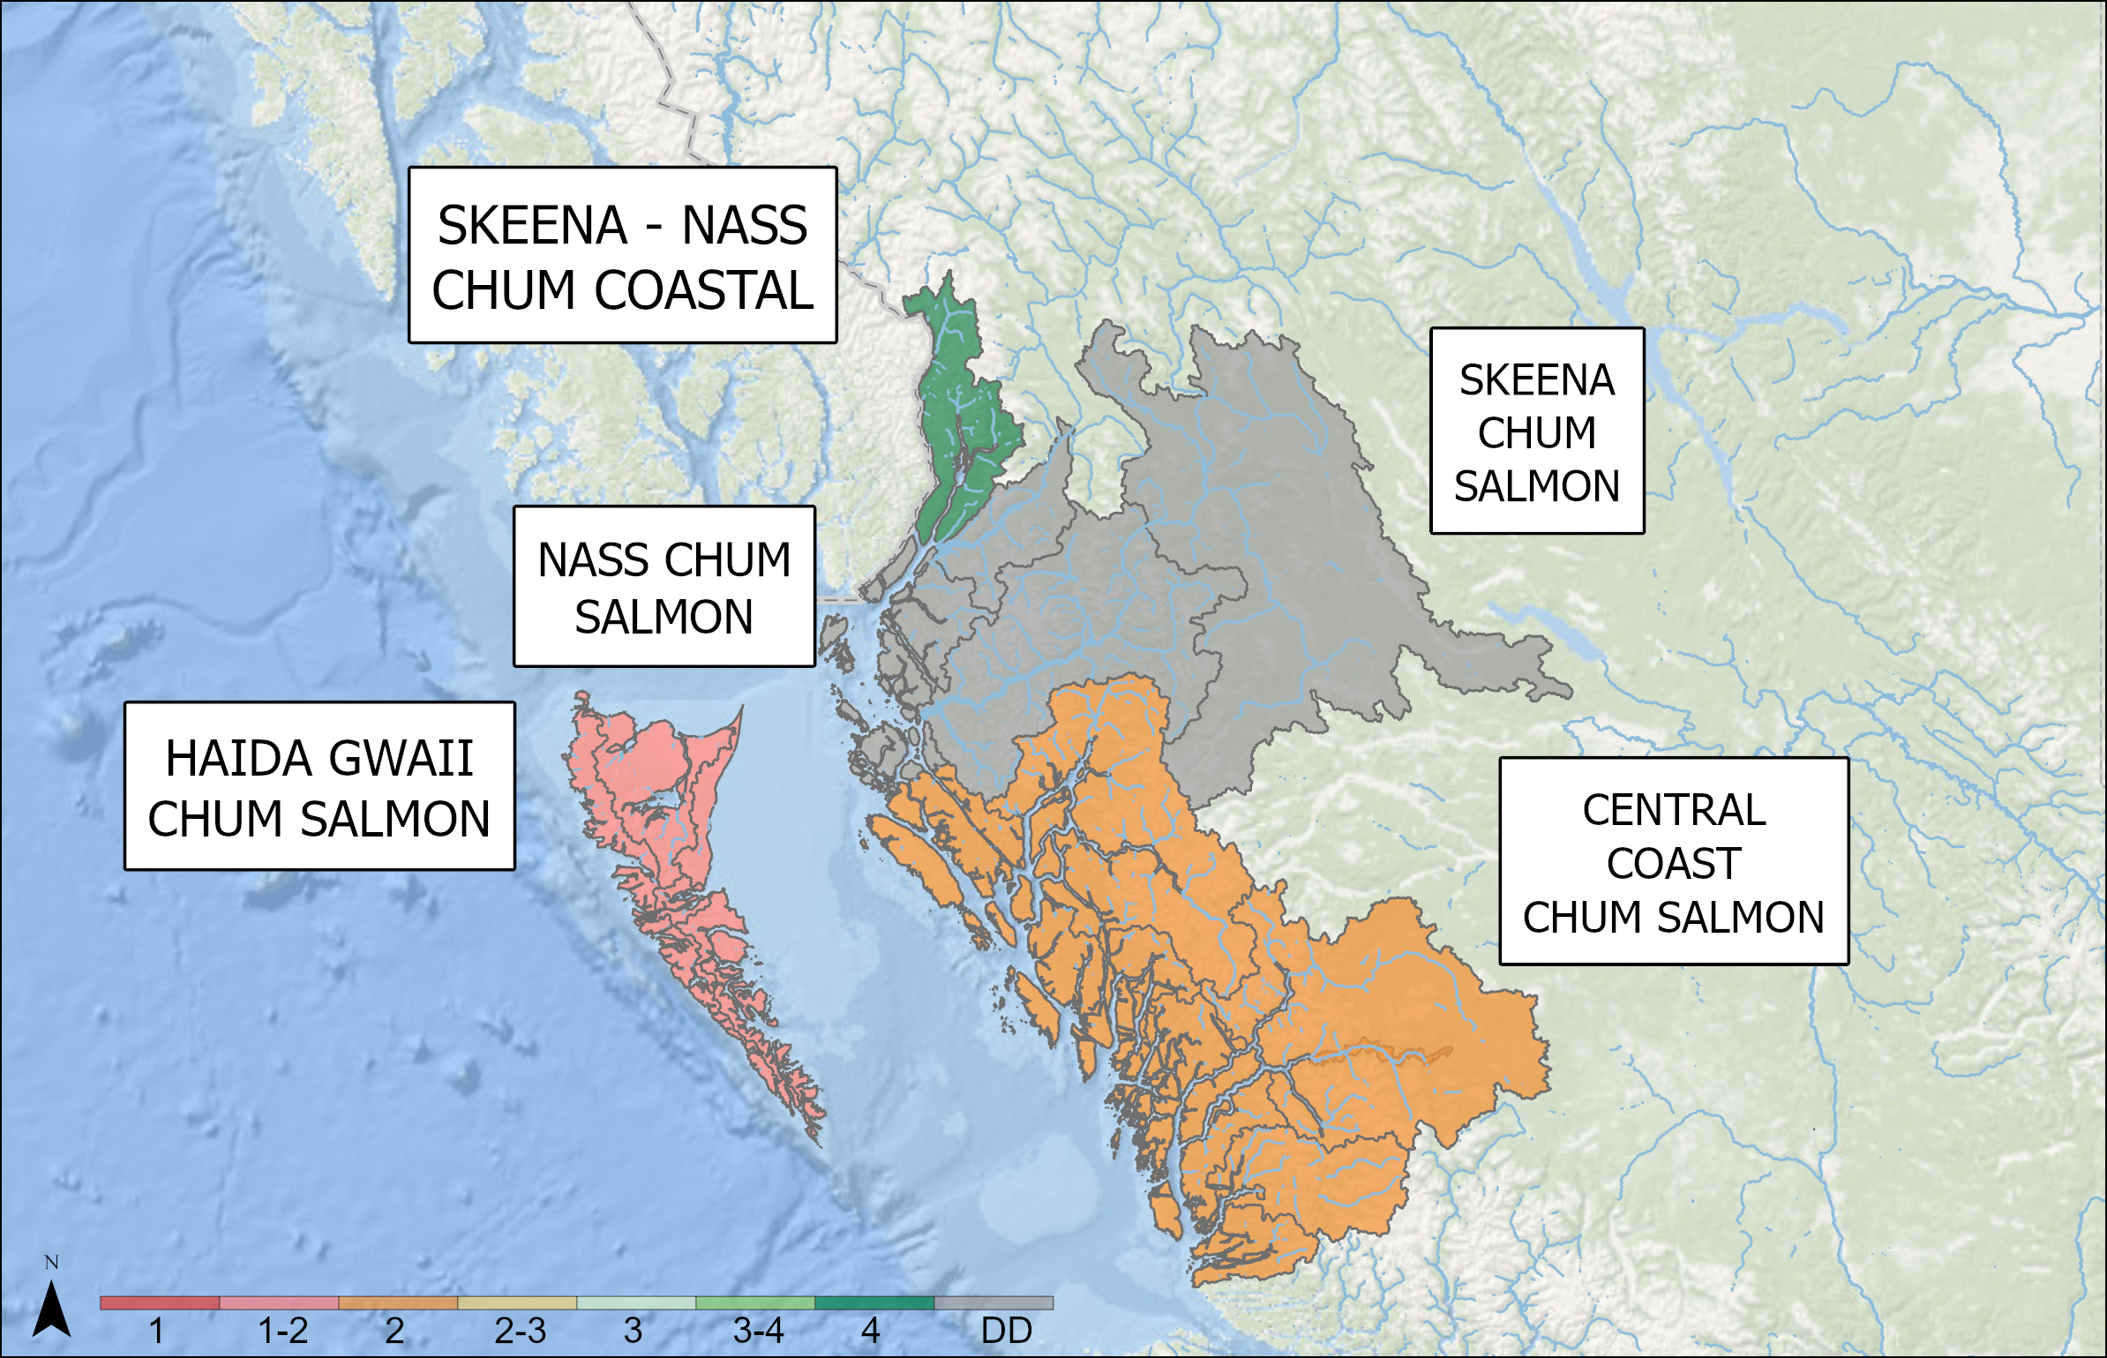
OUTLOOKS – NORTH COAST
North Coast Chum
SMU | Resolution | CU | Outlook
NASS CHUM SALMON | SMU | - | Data Deficient
SKEENA - NASS CHUM COASTAL | CU (aggregate) | PORTLAND INLET, SKEENA ESTUARY | Data Deficient
SKEENA - NASS CHUM COASTAL | CU (singular) | PORTLAND CANAL-OBSERVATORY | 4
SKEENA CHUM SALMON | SMU | - | Data Deficient
HAIDA GWAII CHUM SALMON | SMU | - | 1 to 2
CENTRAL COAST CHUM SALMON | SMU | - | 2
Notes:
NASS CHUM SALMON: -
SKEENA - NASS CHUM COASTAL: - Portland Canal/Observatory CU = Outlook Category 4 The Portland Inlet CU, Skeena Estuary, Lower Nass, and Skeena River CUs are Data Deficient, with some data suggestive of recent annual improvements from historically low productivity. SKEENA CHUM SALMON: -
HAIDA GWAII CHUM SALMON: Status of Area 1 North Haida Gwaii Chum escapement is data deficient however Area 2E and 2W Haida Gwaii escapements suggest continued poor productivity that has been observed for the past two decades.
CENTRAL COAST CHUM SALMON: Abundances within most Central Coast Chum CUs are below average. Bella Coola aggregate of Wild & Enhanced Chum = Outlook Category 3. Dean & Bella Coola River Late CUs are Data Deficient. Aside from the Kimsquit River, estimates from smaller streams within this CU are either less productive (2) or data deficient.

Slide 20
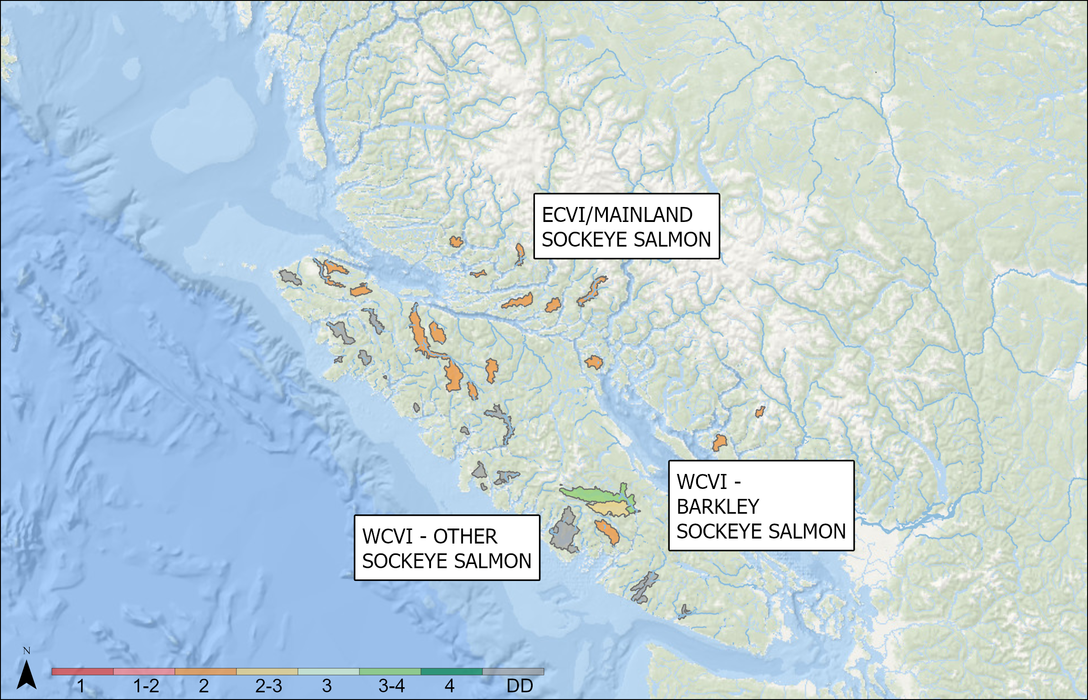
OUTLOOKS – SOUTH COAST
South Coast Sockeye
SMU | Resolution | CU | Outlook
WCVI - BARKLEY SOCKEYE SALMON | CU (singular) | GREAT CENTRAL | 3 to 4
WCVI - BARKLEY SOCKEYE SALMON | CU (singular) | HENDERSON | 2
WCVI - BARKLEY SOCKEYE SALMON | CU (singular) | SPROAT | 2 to 3
WCVI - OTHER SOCKEYE SALMON | SMU | - | Data Deficient
ECVI/MAINLAND SOCKEYE SALMON | CU (singular) | NIMPKISH | 2
Notes:
WCVI - BARKLEY SOCKEYE SALMON: For Somass, the two main contributing brood years for 2026 are 2021 and 2022. Brood abundances were below average and abundant respectively for Sproat Lake (SPL) and average for both years in Great Central Lake (GCL). Based on ocean indicators and returns to date, marine survival rates for the 2023 and 2024 smolt years are good and average respectively. Given the considerations above, expectations are for an average to above average Somass sockeye return in 2025 with an abundant GCL stock and with SPL returning at lower abundance. For the Hucuktlis (Henderson) 2025 return, the two main contributing brood years are 2021 and 2022 which had a little below average escapement. The two main contributing smolt years are 2023 and 2024. Based on ocean indicators, marine survival rates for the 2023 and 2024 smolt years are likely average and below average respectively. Outlook is below average to average.
WCVI - OTHER SOCKEYE SALMON: Assessment data are not available to forecast others systems. Anecdotal information indicates some populations (e.g. Kennedy Lake) are greatly depressed, while others (e.g. Bedwell) are seeing moderate returns in recent years.
ECVI/MAINLAND SOCKEYE SALMON: For the 2026 return, the two main contributing brood years are 2021 (24,978) and 2022 (No Data due to high water). The 2021 return was well below average, while the lack of data for 2022 increases uncertainty in our outlook. Despite these outcomes for 2021 and 2022, acoustic trawl surveys of Woss Lake were successful and rearing abundances of juvenile sockeye were within the realm of historical observations. Sockeye returning in 2026 will have entered the ocean in 2023 and 2024. We have seen evidence of improved marine survival for these ocean entry years for Pink and Coho Salmon returning to nearby systems. Nimpkish Sockeye typically return as 4-year-old fish (57%), but the 5-year component can also be strong. Given the considerations above, and a stronger than expected return in 2024 and 2025, we anticipate that escapement will be average in 2025. Outlook category 2

Slide 21
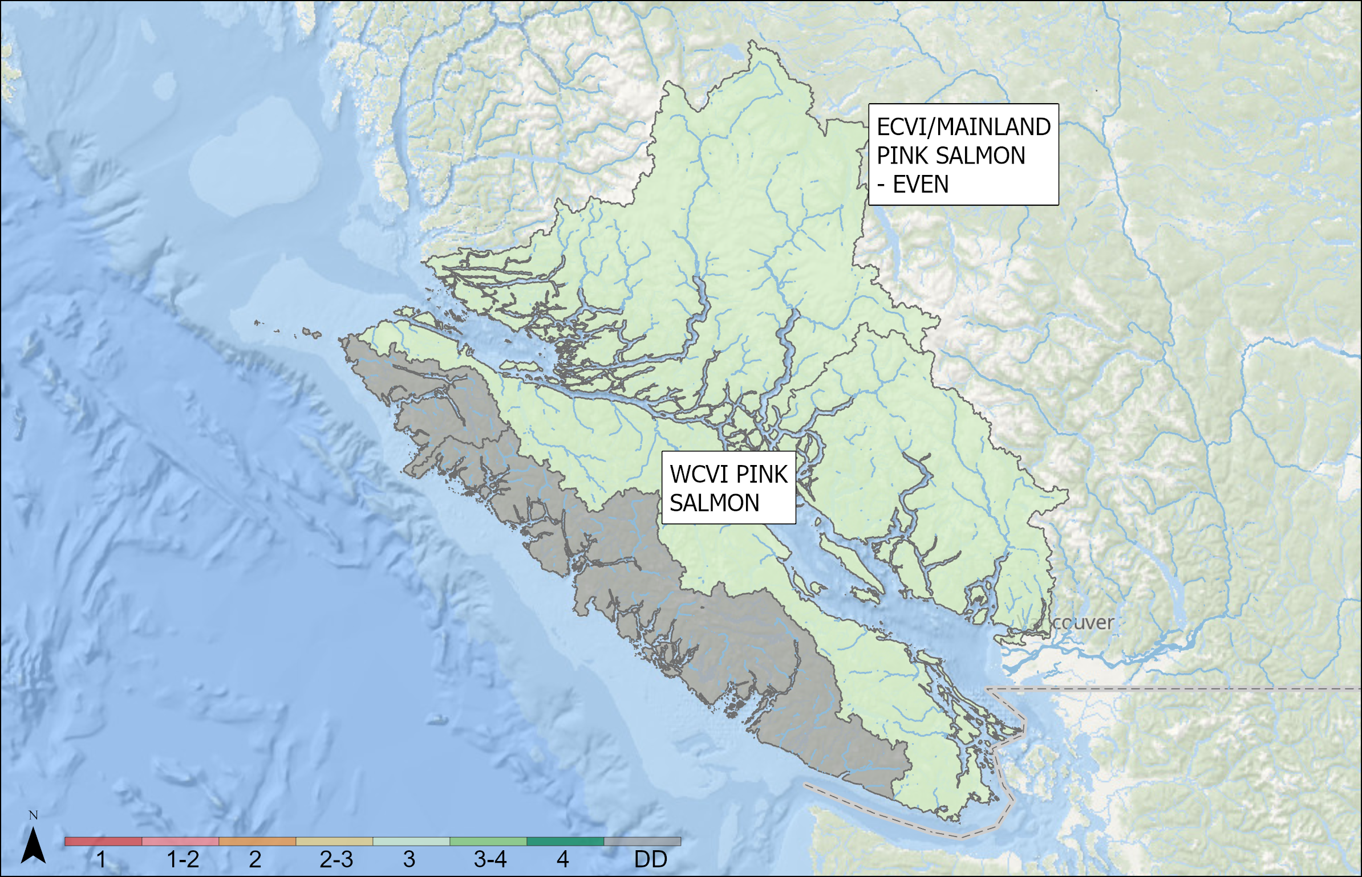
OUTLOOKS – SOUTH COAST
South Coast Pink
SMU | Outlook
WCVI PINK SALMON | Data Deficient
ECVI/MAINLAND PINK SALMON - EVEN | 3
Notes:
WCVI PINK SALMON: -
ECVI/MAINLAND PINK SALMON - EVEN: Even Year: 2024 saw improved returns throughout the South Coast with returns approaching or exceeding the long-term average for systems on Vancouver Island and in the Mainland Inlets. Returns were somewhat below the long-term average for the mainland, but most systems exceeded the recent (3 cycle) generational average. Expectations for 2026 are for a stabilization of abundance for Pink Salmon returning to ECVI and the mainland. Pink returns are highly variable, and confidence in the forecasted return in 2026 is low, but average returns to this region are expected in 2026

Slide 22
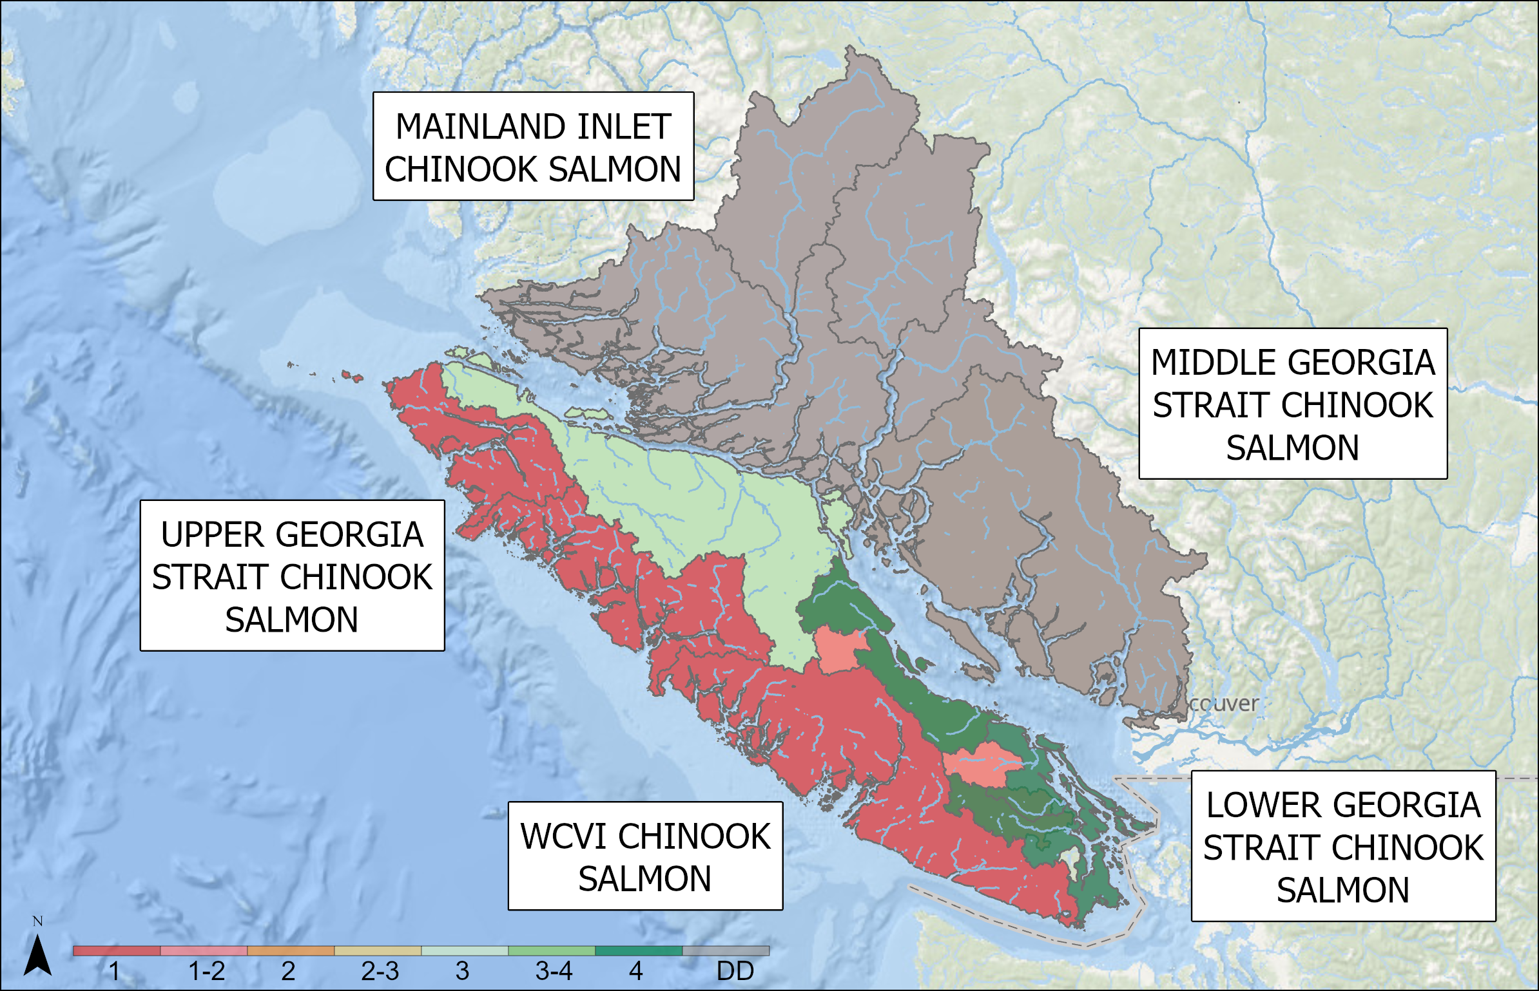
OUTLOOKS – SOUTH COAST
South Coast Chinook
SMU | Resolution | CU | Outlook
WCVI CHINOOK SALMON | SMU | CK-31, CK-32. CK-33 | 1
WCVI CHINOOK SALMON | Hatchery or Indicator Stock | Robertson Creek Hatchery | 3 to 4
WCVI CHINOOK SALMON | Hatchery or Indicator Stock | Nitinat River Hatchery | 2
WCVI CHINOOK SALMON | Hatchery or Indicator Stock | Conuma River Hatchery | 3 to 4
LOWER GEORGIA STRAIT CHINOOK SALMON | SMU | - | 4
MAINLAND INLET CHINOOK SALMON | SMU | - | Data Deficient
MIDDLE GEORGIA STRAIT CHINOOK SALMON | CU (singular) | EAST VANCOUVER ISLAND-GEORGIA STRAIT_SU_0.3 | 1-2
MIDDLE GEORGIA STRAIT CHINOOK SALMON | CU (singular) | EAST VANCOUVER ISLAND-QUALICUM AND PUNTLEDGE_FA_0.X | 4
MIDDLE GEORGIA STRAIT CHINOOK SALMON | CU (singular) | SOUTHERN MAINLAND-GEORGIA STRAIT_FA_0.X, | Data Deficient
UPPER GEORGIA STRAIT CHINOOK SALMON | SMU | - | 3
Notes:
WCVI CHINOOK SALMON: WCVI wild Chinook remain a stock of concern. Escapements of WCVI Chinook natural populations remain low. The Clayoquot area (SWVI), and Kyuquot (NWVI) wild indicators remain a big concern. It is assumed survival rates of natural-origin Chinook are well below those of hatchery-origin, productivity is therefore anticipated to remain low. Returns of hatchery Chinook stocks to the WCVI were strong in 2025 in general, consistent with the favourable ocean-entry conditions observed in 2022 and 2023. Ocean-entry conditions in 2023 appear favourable and 2024 appear not as favourable for return year 2026. Robertson creek saw a good return in 2025 with a preliminary estimate being 125,000. over 50% of these were age 3-1 and we expect that cohort to make a strong showing as 4-1s. Returns in 2025 to Conuma and Nitinat hatcheries were above and below average respectively we expect 2026 returns to be similar, until we have biological samples processed with which to run a formal forecast.
LOWER GEORGIA STRAIT CHINOOK SALMON: Adult Chinook returns to the Cowichan River in 2025 exceeded the target escapement of 6,500 naturally spawning adults for the tenth consecutive year, recovering from a low of 540 natural spawners in 2009. Preliminary 2025 returns were above the 90th percentile, estimated at 32,366 adults and 18,872 Jacks. Wild production continues to drive escapement with the proportion of hatchery fish in the population estimated at less than 10% for adult age classes in 2025. The 2026 outlook is for average to above average returns. A similar rebuilding trend has not been observed in the Nanaimo River. 2025 counts were below the 4 year average with 8,510. Expectations for 2026 are for average returns. 2025 Outlook Category 4. MAINLAND INLET CHINOOK SALMON: Includes Homathko and Klinaklini. DFO is working to expand our programs into the Mainland Inlets. Since 2021, a video counter was installed on Devereux Creek and average annual returns are 850, although additional data review is required. Since 2022, an intensive mark-recapture project has been undertaken on the Southgate River in Bute Inlet and estimated returns have ranged from 832 to 5,175. Although still data deficient, efforts are underway to understand population abundance and trends in these areas. MIDDLE GEORGIA STRAIT CHINOOK SALMON: The Puntledge River saw a long term average return of 8,354 fall Chinook in 2025, while the Big Qualicum River had an above average return at 15,201. Stable production levels and modest survivals for several hatchery indicators combined with above average returns of 3-year olds suggests average to above average returns are likely for 2026. 2025 Outlook Category 4. A combination of additional snorkel surveys and a DIDSON project in the Nanaimo River produced an estimate of 591 fish in 2025, which was near the 4-year average of 680 but below the recovery target of 1785. Puntledge summer Chinook were below the 4-year average of 304 fish at 93 and well below the recovery target of 2125. Most of the reduction can be attributed to reduced smolt releases in preceding years. Rebuilding efforts for these populations are continuing with recovery potential assessments recently completed. At these levels, rebuilding will take several generations even with improved survival. 2025 Outlook Category 2/3 for Nanaimo and 1 for Puntledge. UPPER GEORGIA STRAIT CHINOOK SALMON: We saw above average escapement in 2025 for the Quinsam/Campbell River, and average to above average returns elsewhere. Recent escapement estimates on the Quinsam/Campbell are likely biased low due to uncharacteristically high carcass predation, but that challenge was somewhat mitigated for 2025 with the addition of a live-tagging component to the escapement program, and the 2025 estimate reflects this new method. Below average to average returns for the brood years contributing to the 2025 return, continuing restrictions on early timed Fraser Chinook, and relatively stable marine survival in recent years suggests we will see average returns in 2026. Outlook category 3.

Slide 23
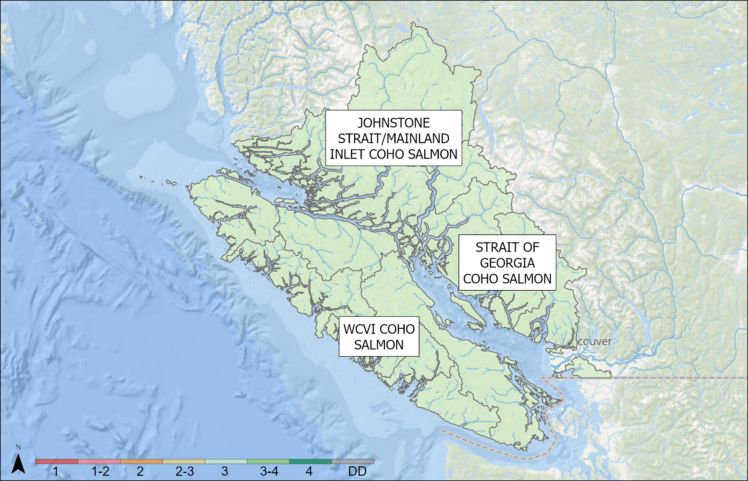
OUTLOOKS – SOUTH COAST
South Coast Coho
SMU | Outlook
WCVI COHO SALMON | 3
JOHNSTONE STRAIT/MAINLAND INLET COHO SALMON | 3
STRAIT OF GEORGIA COHO SALMON | 3
Notes:
JOHNSTONE STRAIT/MAINLAND INLET COHO SALMON: Coho in Area 12 experienced extremely poor survival between 2016 and 2019, but returns to the wild indicator at the Keogh River have increased in the years since. Marine survival remains highly variable, with generally strong smolt production buffering periods of poor marine survival and providing for above average escapements when marine conditions improve. The estimate of 3,263 adult Coho returning to the Keogh in 2025 stems from the relatively poor smolt abundance observed in 2024 (52,546), indicating that marine survival for this population increased dramatically for juvenile Coho Salmon entering the ocean in 2024. We expect average returns in 2026 due to apparent strong smolt production in 2025, combined with variable but generally poor marine survival observed in this region. Returns to the Northern Strait of Georgia have generally been increasing in recent years, with high survival observed across the hatchery (Quinsam and Big Qualicum rivers) and wild (Black Creek) indicators. Adult returns to the Quinsam were well above average. The wild Coho indicator at Black Creek also saw well above average adult (5,181) and the highest jack returns ever observed (8,662). General observations to date suggest the 2025 forecast under-estimated returns, given smolt production at Black Creek was amongst the lowest observed in recent years (39,000). Expectations for 2026 are for average to above average escapement, following a return to high smolt production in 2025. STRAIT OF GEORGIA COHO SALMON: Hatchery indicators for this Outlook Unit are the Quinsam and Big Qualicum rivers. 2025 returns of 32,678 to the Big Qualicum were well above the long term average of 16.2K. Production levels are stable and 2026 returns are expected to be above average. Quinsam River adult returns in 2025 were also above average. The wild indicator is Black Creek. This year’s preliminary estimate of 5,181 adults is above the long-term average of 3,451. Jack returns were significantly above the long term average of 1,381 with a preliminary estimate 8,662; the highest on record since 1985. The preliminary marine survival estimate for the 2024 ocean entry cohort is above the recent average. WCVI COHO SALMON: Information on Coho returns is limited and results in forecast uncertainty. Data suggests improved Coho marine survival in 2025 relative to recent years. Preliminary 2025 results suggest above 8-year average returns on Stamp (30% above average), Sproat (153% above average), Carnation (94% above average). For 2026, most of the return will originate from the 2023 brood year that went to sea in 2025. The 2023 brood year was similar to the 2022 brood year for Robertson and Carnation, however for other wild systems the general trend for the 2023 brood year is less than the 2022 brood year. When entry ocean conditions in 2025 are examined, we will have a better understanding of the outlook.

Slide 24
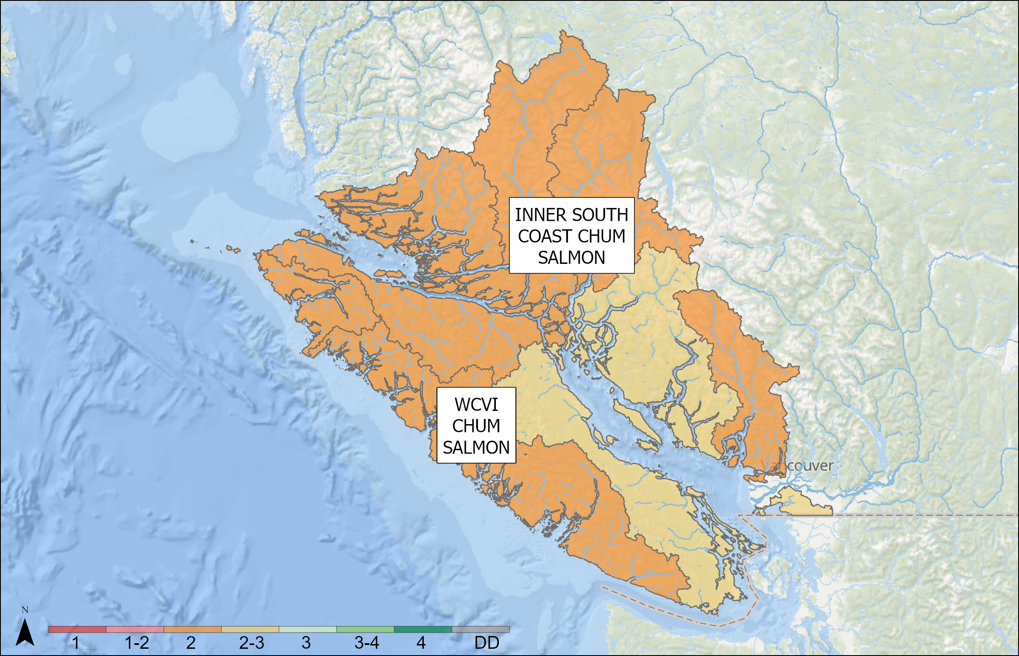
OUTLOOKS – SOUTH COAST
South Coast Chum
SMU | Res | CU | Outlook | Forecast
WCVI CHUM SALMON | SMU | - | 2
INNER SOUTH COAST CHUM SALMON | CU (sing) | GEORGIA STRAIT | 2 to 3 | Target forecasts: Jervis Inlet: 45,000 Mid VI (Puntledge, Big Q, Little Q): 230,000 Nanaimo River: 40,000 Cowichan River: 160,000 Goldstream River: 15,000
INNER SOUTH COAST CHUM SALMON | CU (agg) | HOWE SOUND-BURRARD INLET, NORTHEAST VANCOUVER ISLAND, LOUGHBOROUGH, BUTE INLET, SOUTHERN COASTAL STREAMS, UPPER KNIGHT | 2
Notes:
WCVI CHUM SALMON: Preliminary 2025 returns of WCVI Chum to most systems were not as good as last year but improved compared to last several years. Poor brood years 2021, 2022, and 2023 will contribute to the 2026 return as age 5, 4 and 3, respectively. Poor brood performance appears to be buffered by substantial improvements in marine survival for the 2019-2022 ocean entry years. 2024 performed well, 2025 not as well, and for 2026 is less certain. In addition, hatchery production has declined in recent years.
INNER SOUTH COAST CHUM SALMON: (CM-04)2025 results indicate below forecast recruitment for systems in mid to northern Georgia Strait and Jervis/Narrows Inlets. Returns to Nanaimo were slightly above forecast, Cowichan as expected and Goldstream were poor. For 2026, mid-Island systems (Puntledge, Little Qualicum, Big Qualicum) are expected to remain well below target levels. Nanaimo and Goldstream have the potential to see above target escapements depending on recruitment rates while Cowichan is forecast to be about half of the 160K target. Jervis/Narrows Inlet stocks are forecast to be well below target abundance. (CM-03, CM-05 to 09)(Fall run Chum Salmon stocks in 2025 appear to have mixed performance, although all surveyed systems generally saw lower returns than in 2024, in line with expecations of reduced returns due to low abundance for the dominant brood year (2021). We anticipate that the ISC Chum return in 2026 will be improved from those observed in 2025, largely due to improved escapement for the dominant brood year (2022), and generally improved ocean conditions. Relative to the 2024 return, the brood year abundance for the 2026 return (2021-2023) was somewhat higher, particularly for the dominant brood year (2022). However, ocean productivity indicators were not as favourable as those for the 2024 return year. The outlook category for 2026 is 2.

Slide 25
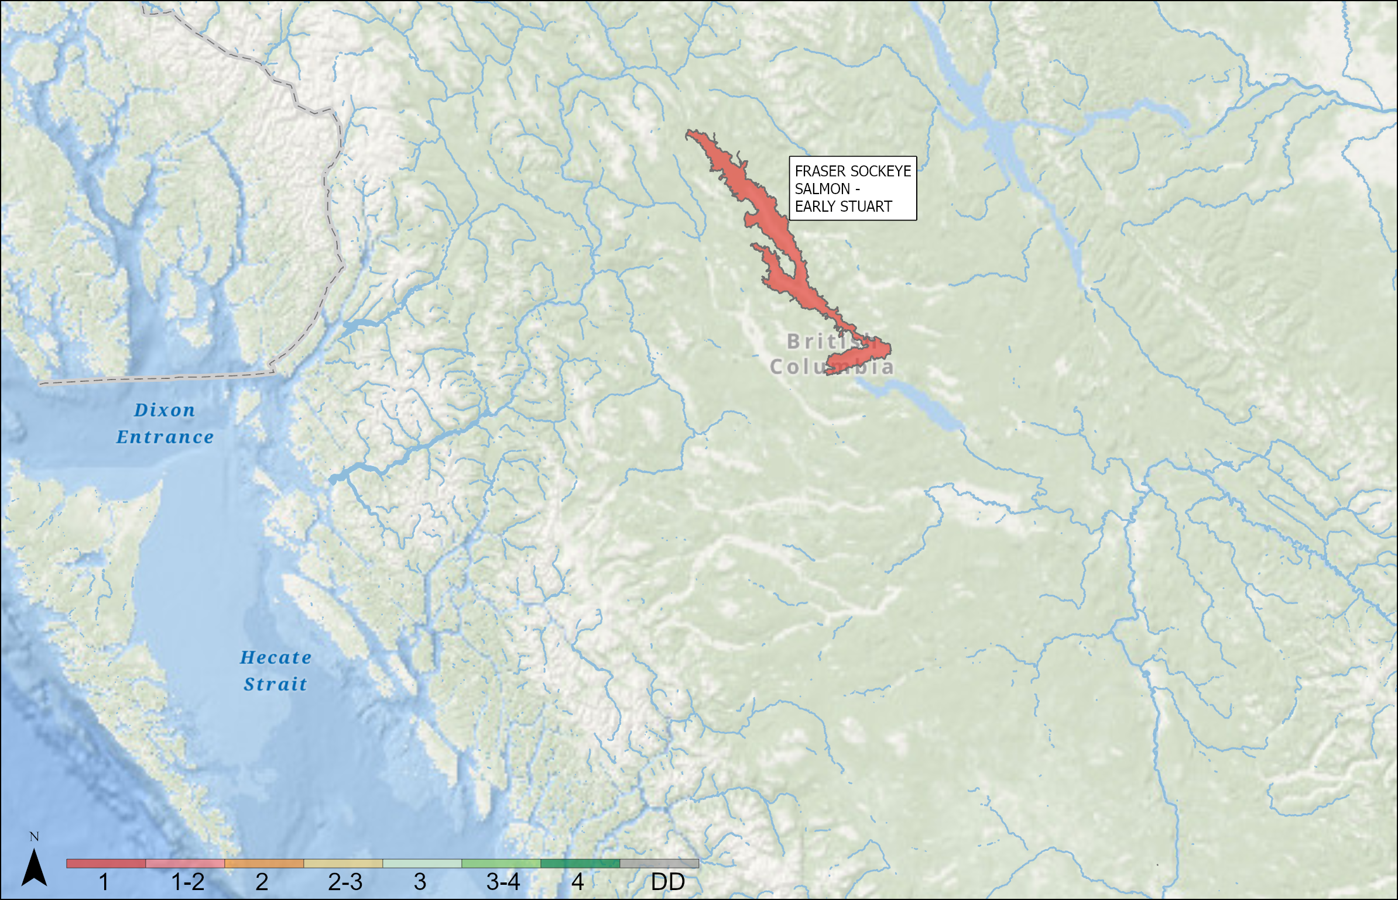
OUTLOOKS – FRASER AND INTERIOR
Fraser River and Interior Sockeye – Early Stuart
SMU | Resolution | CU | Outlook
FRASER SOCKEYE SALMON - EARLY STUART | CU (singular) | TAKLA/TREMBLEUR-EARLY STUART TIMING | 1
Notes:
FRASER SOCKEYE SALMON - EARLY STUART: TAKLA/TREMBLEUR-EARLY STUART TIMING: Poor return is expected in 2026. The 2022 brood year effective total spawners (ETS; 18,899) and effective female spawners (EFS; 5,279) are below all metrics, including the WSP lower benchmark for ETS (111,753), and the long-term and recent cycle line average EFS (18,136 and 21,052 respectively).

Slide 26
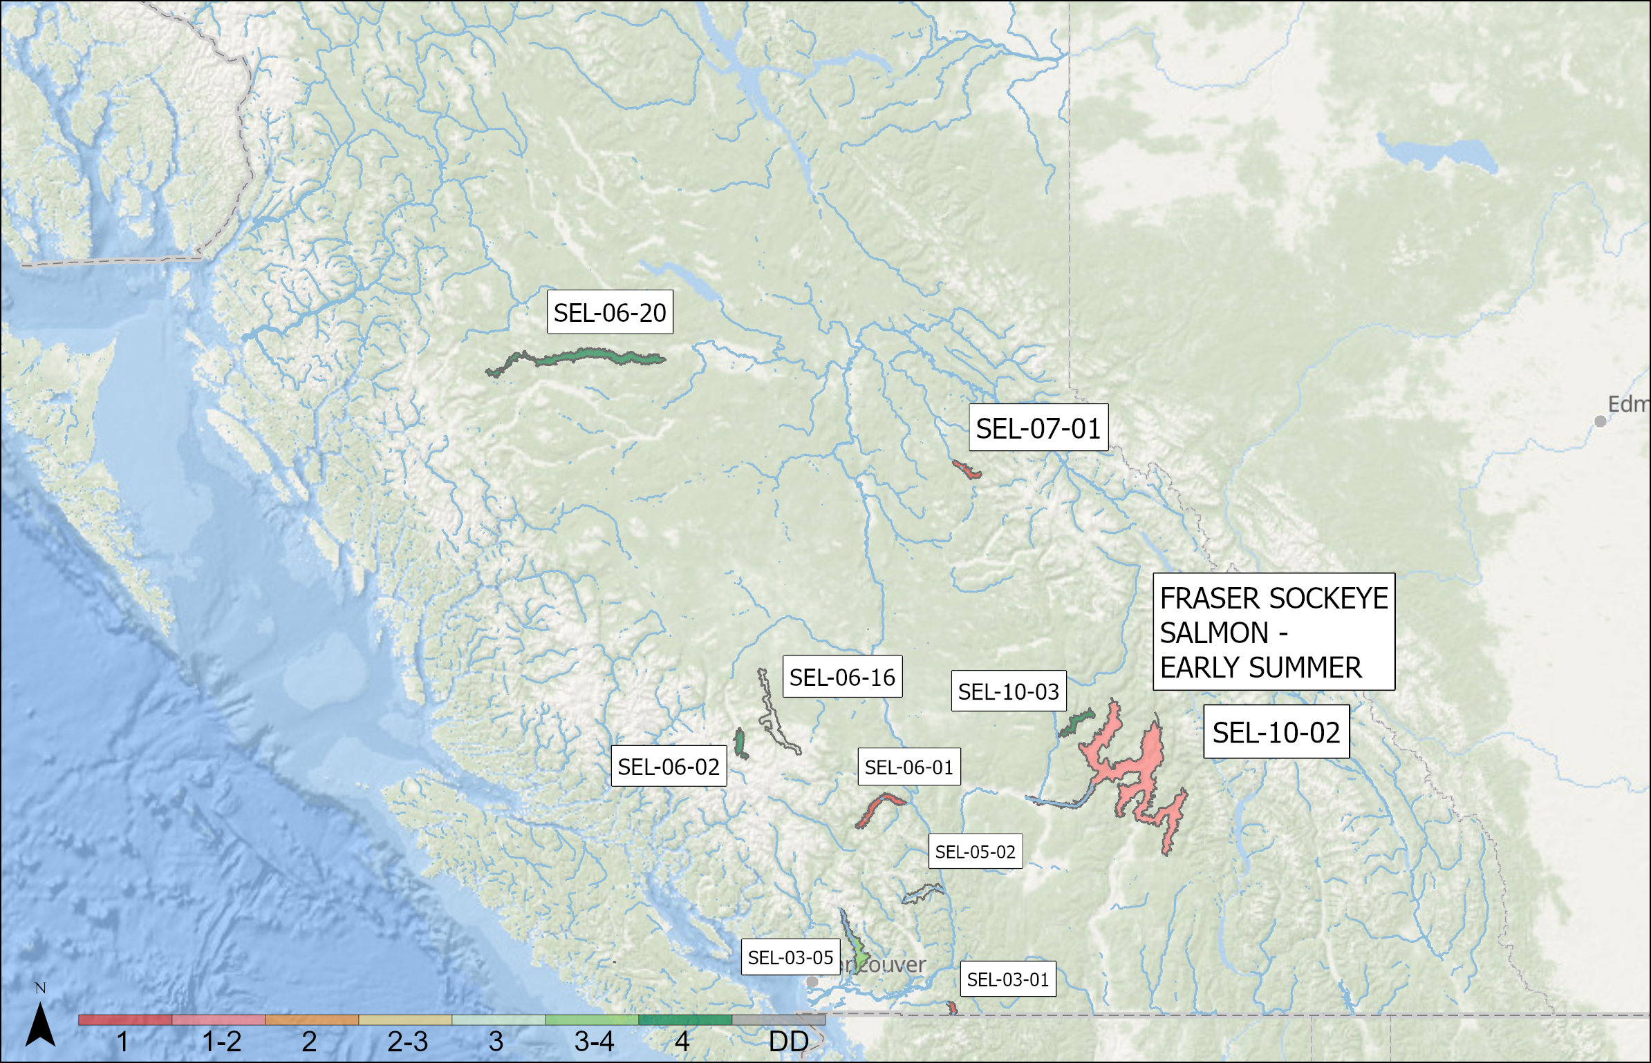
OUTLOOKS – FRASER AND INTERIOR
Sockeye – Early Summer
SMU | Resolution | CU | Outlook
FRASER SOCKEYE SALMON - EARLY SUMMER | CU (singular) | BOWRON-EARLY SUMMER TIMING | 1
FRASER SOCKEYE SALMON - EARLY SUMMER | CU (singular) | NORTH BARRIERE-EARLY SUMMER TIMING | 4
FRASER SOCKEYE SALMON - EARLY SUMMER | CU (singular) | ANDERSON/SETON-EARLY SUMMER TIMING | 1
FRASER SOCKEYE SALMON - EARLY SUMMER | CU (singular) | NADINA/FRANCOIS-EARLY SUMMER TIMING | 4
FRASER SOCKEYE SALMON - EARLY SUMMER | CU (singular) | PITT-EARLY SUMMER TIMING | 3 to 4
FRASER SOCKEYE SALMON - EARLY SUMMER | CU (singular) | TASEKO-EARLY SUMMER TIMING | 4
FRASER SOCKEYE SALMON - EARLY SUMMER | CU (singular) | CHILLIWACK-EARLY SUMMER TIMING | 1
FRASER SOCKEYE SALMON - EARLY SUMMER | CU (singular) | NAHATLATCH-EARLY SUMMER TIMING | 4
FRASER SOCKEYE SALMON - EARLY SUMMER | CU (singular) | SHUSWAP COMPLEX-EARLY SUMMER TIMING | 1 to 2
Notes:
BOWRON-EARLY SUMMER TIMING: The 2026 return is expected to be well below the historic average of 32,704. This stock can have a large five-year-old component in some years. The 2022 brood year ETS (3,119) was below the WSP lower benchmark of 5,249. The 2021 brood year ETS (2,886) was also low. EFS for 2021 (1,609) is well below the long term and recent averages (3,834 and 828, respectively) while the 2022 EFS (1,781) is above the recent average but below the long term average.
NORTH BARRIERE-EARLY SUMMER TIMING: The 2026 return is expected to be above average. The 2022 brood year ETS (5,198) is¬ above the lower WSP benchmark of 640 and slightly above the upper benchmark of 5,097. The brood year EFS (2,522) is slightly below the long term average of 3,581 but well aboe the recent average of 966.
ANDERSON/SETON-EARLY SUMMER TIMING: A poor return is expected for this stock. The 2022 brood year ETS (2,385) is well below the WSP upper benchmark (22,534). Brood year EFS (1,296) is below the long-term average (4,418) and the recent average (6,461). Note that these comparisons included the Gates River spawning channel, but, as of January 2020, the channel has not been operational, which will influence interpretation of these trends moving forward (Grant et al. 2020).
NADINA/FRANCOIS-EARLY SUMMER TIMING: The 2026 return is expected to be above average. While the 2021 ETS (11,834) is lower than the lower WSP benchmark of 21,694, the 2022 ETS (234,089) represents the largest recorded escapement and is well above the upper WSP benchmark of 68,273. EFS in 2021 (6,906) is well below the long term and recent averages of 12,393 and 34,213 while the EFS in 2022 (105,687) is well above both of these metrics.
PITT-EARLY SUMMER TIMING: An above-average return is expected in 2026. Upper Pitt has a higher proportion of five-year-old recruits (~78%) relative to four-year-old recruits. However, an above average return from the 2021 brood year may bolster returns this year. The 2021 brood year ETS (14,513) is above the WSP lower benchmark (10,627), and EFS (6,669) is above both the long-term and recent averages (12,867 and 5,026, respectively). The 2022 brood year ETS and EFS are 22,020 and 10,900, respectively, with the total spawners above the WSP lower benchmark and the EFS being below the long term average but more than double the recent average. Note: these comparisons include esapements to the Upper Pitt River spawning channel to be consistent with Grant et al. 2020.
TASEKO-EARLY SUMMER TIMING: Reliable return data are not available for this CU, thus no WSP benchmarks are available (see Appendix 1). Above average returns are expected in 2026. In 2022, estimated ETS and EFS were 1,913 and 957, respectively. By comparison, long term and recent average EFS values were 1,167 and 422, respectively. Limited sample size precludes analysis of the age structure of Taseko Sockeye.
CHILLIWACK-EARLY SUMMER TIMING: While this stock exhibits cyclical returns, limited data preclude cycle-specific benchmarks (Grant et al 2020). The uncertainty in both the age structure and relevant benchmarks for comparison is reflected in the Outlook status. A poor return is expected in 2026. The 2022 brood year ETS is 3,591. The 2022 EFS (1,899) is below the long term and recent averages for this cycle line (1,474 and 1,530, respectively).
NAHATLATCH-EARLY SUMMER TIMING: Reliable recruitment data are not available for this CU, thus no WSP benchmarks are available for comparison (see Appendix 1). An above -average return is expected in 2026, as the 2022 brood year EFS was 2,516, which is above both the long term average (2,075), and recent average (1,899).
SHUSWAP COMPLEX-EARLY SUMMER TIMING: Poor to below average returns are expected for this CU. The Seymour River and Scotch Creek combined four-year old brood year ETS (75,213) is above the WSP lower benchmark (36,380) but below the upper benchmark (141,746) for this cycle line. Seymour River brood year EFS (11,808) is less than half of the long-term (46,747) and well below the recent (97,925) averages for the cycle line. EFS for Scotch Creek (22,900) is also well below long term (32,668) and recent (98,729) averages. Although brood year escapements are above the WSP lower benchmark, they are well below recent and long term averages on the dominant cycle line for this highly cyclic CU.
SEYMOUR RIVER: Category 1, SCOTCH CREEK: Category 2

Slide 27
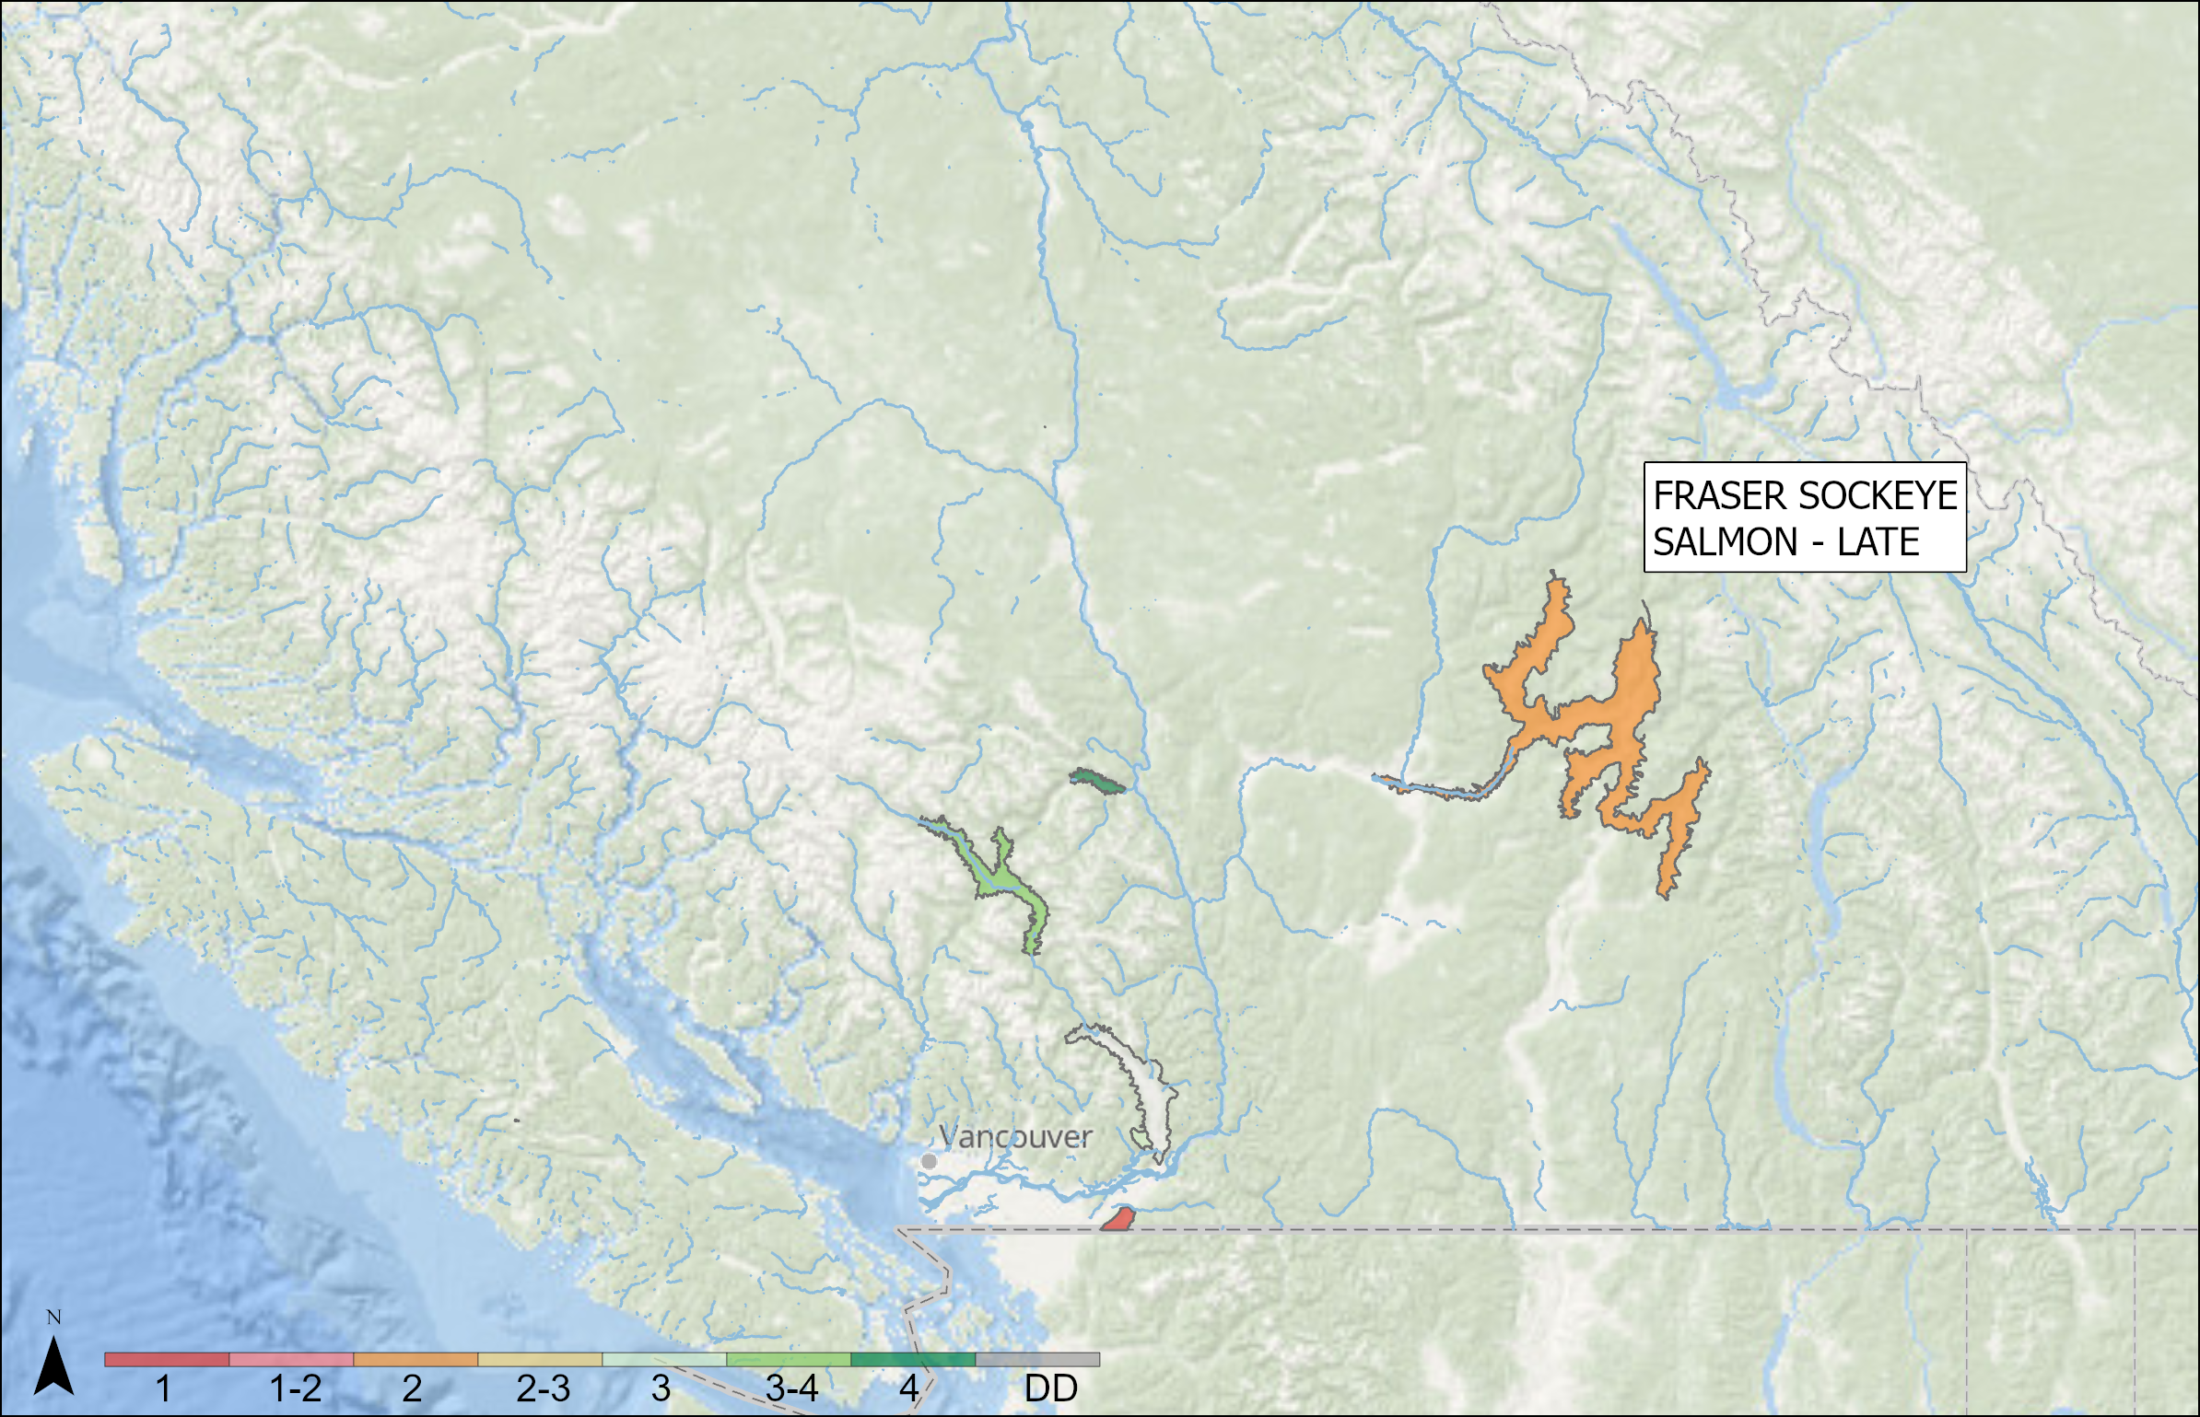
OUTLOOKS – FRASER AND INTERIOR
Fraser River and Interior Sockeye - Late
SMU | Resolution | CU | Outlook
FRASER SOCKEYE SALMON - LATE | CU (singular) | SHUSWAP COMPLEX-LATE TIMING | 2
FRASER SOCKEYE SALMON - LATE | CU (singular) | LILLOOET/HARRISON-LATE TIMING | 3 to 4
FRASER SOCKEYE SALMON - LATE | CU (singular) | CULTUS-LATE TIMING | 1
FRASER SOCKEYE SALMON - LATE | CU (singular) | SETON-LATE TIMING | 4
FRASER SOCKEYE SALMON - LATE | CU (singular) | HARRISON-UPSTREAM MIGRATING-LATE TIMING | 3
FRASER SOCKEYE SALMON - LATE | CU (singular) | HARRISON-DOWNSTREAM MIGRATING-LATE TIMING | 2
Notes:
SHUSWAP COMPLEX‑LATE TIMING: A below average return is expected for this CU. Brood year ETS (703,128) more than double the WSP lower benchmark of (310,783) but well below the upper benchmark of 1,794,869. Brood year EFS (376,518) is less than half the long term average (1,134,793), less than half of the recent average EFS (1,326,060), and is the lowest EFS value on record for the dominant cycle line for Late Shuswap sockeye.
LILLOOET/HARRISON‑LATE TIMING: An above average to average return is expected in 2026. The 2021 and 2022 brood year ETS were 45,018 and 117,884 respectively which are both above the lower benchmark of 15,685. The 2022 brood year ETS is above the upper benchmark of 81,023. The 2021 brood year EFS (23,510) is below the long term and recent averages of 39,322 and 21,819 but the 2022 brood year EFS (60,148) is greater than both of these metrics.
CULTUS‑LATE TIMING: A poor return is expected for this CU. Brood year ETS is 514, extremely small relative to the WSP lower benchmark (15,454). Brood year EFS (266) is also far below the long‑term average (792), but is above the recent average (95). The smolt out‑migrant estimate in 2024 was 68,890, well below the average of 115,299 (2001‑2023).
SETON‑LATE TIMING: Above average returns are expected for this CU. The brood year ETS of 18,196 is well above the WSP lower benchmark of 2,193 and above the WSP upper benchmark of 13,453. The brood year EFS (10,585) is more than double both the long‑term (4,282) and recent averages (3,199).
HARRISON‑UPSTREAM MIGRATING‑LATE TIMING: Near average returns are expected for this CU. The 2022 brood year ETS (50,678) is above the WSP lower benchmark (10,731) but below the WSP upper benchmark (84,597). Brood year EFS (20,787) is slightly above the long‑term (20,404) but above the recent average (14,573). These comparisons include escapement to the Weaver Creek spawning channel to be consistent with Grant et al. (2020).
HARRISON‑DOWNSTREAM MIGRATING‑LATE TIMING: Reliable return data are not available for this CU, thus no WSP benchmarks are available (see Appendix 1). Poor returns are expected for this stock, since the 2022 brood year EFS (669) was low compared to the long‑term (1,597) and recent average EFS (389).

Slide 28
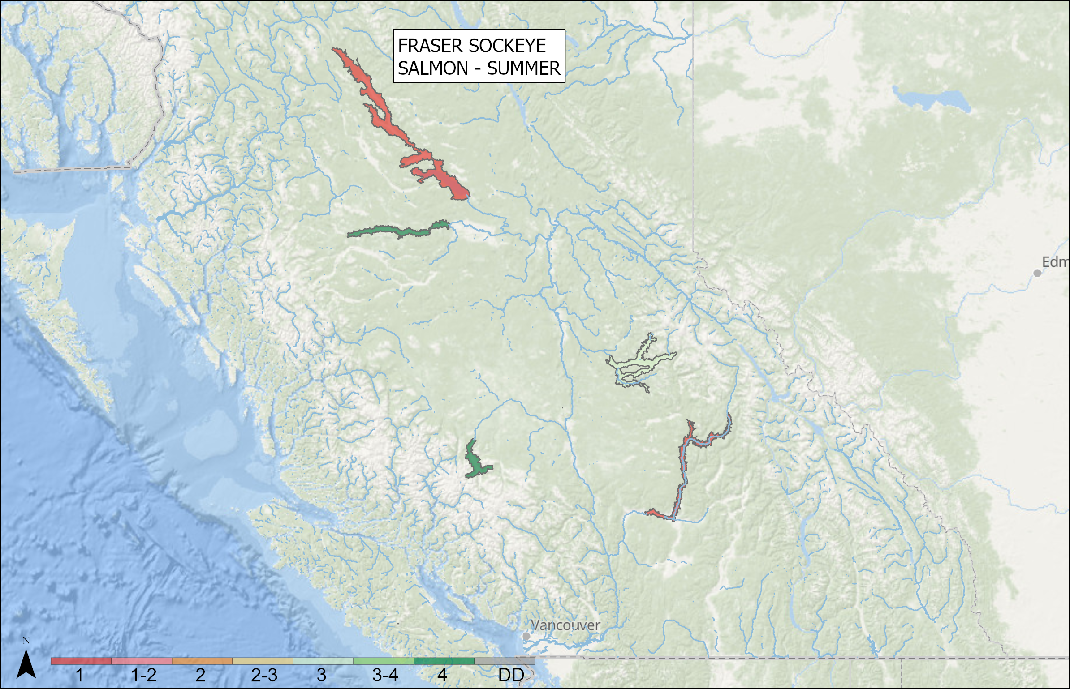
OUTLOOKS – FRASER AND INTERIOR
Fraser River and Interior Sockeye – Summer
SMU | Res | CU | Outlook
FRASER SOCKEYE SALMON - SUMMER | CU (singular) | TAKLA/TREMBLEUR/STUART-SUMMER TIMING | 1
FRASER SOCKEYE SALMON - SUMMER | CU (singular) | FRANCOIS/FRASER-SUMMER TIMING | 4
FRASER SOCKEYE SALMON - SUMMER | CU (singular) | KAMLOOPS-EARLY SUMMER TIMING | 1
FRASER SOCKEYE SALMON - SUMMER | CU (singular) | QUESNEL-SUMMER TIMING | 3
FRASER SOCKEYE SALMON - SUMMER | CU (aggregate) | CHILKO-EARLY SUMMER TIMING, CHILKO-SUMMER TIMING | 4
FRASER SOCKEYE SALMON - SUMMER | CU (singular) | HARRISON RIVER | 1
FRASER SOCKEYE SALMON - SUMMER | CU (singular) | WIDGEON | 2
Notes:
TAKLA/TREMBLEUR/STUART-SUMMER TIMING: A poor return is exepcted in 2026. The 2022 brood year ETS of 87,161 is below the WSP lower benchmark (132,547). Brood year EFS (41,588) is below the long-term (28,226) average and slightly below the recent (45,095) average for this cycle line.
FRANCOIS/FRASER-SUMMER TIMING: Above average returns are expected in 2026. The 2022 brood year ETS (122,758) was well above the WSP lower benchmark (24,256), and slightly above the upper benchmark of 122,612. Brood year EFS (57,153) was similar to the long-term (55,266) and above recent (42,033) averages.
KAMLOOPS-EARLY SUMMER TIMING: The 2026 return is expected to be below the long-term average (29,173). The 2022 ETS (3,667) is below the WSP lower benchmark of 4,958. 2022 EFS (1,781) is below the long-term average (4,106), but similar to the recent average (1,605).
QUESNEL-SUMMER TIMING: An average return is expected for this cyclical CU in 2026. The 2022 brood year ETS of 763,010 was higher than the WSP lower benchmark of 197,467 but lower than the upper benchmark of 1,307,742. EFS in the 2022 (414,835) was well above the long term average (163,873) and above below the recent average (327,483) for this cycle line.
CHILKO-EARLY SUMMER TIMING: Above-average returns are expected in 2026 relative to the historical average (1,350,479). The 2022 brood year ETS of 872,969 is well above the upper (353,863) benchmarks. Brood EFS (484,123) is above both the long-term (229,374) and recent (281,341) averages. The smolt out-migrant estimate in 2024 was 49 million, which is more than double the historic average of 22.8 million.
HARRISON RIVER: Poor returns are expected for this CU, but this will strongly depend not only on survival, but also the maturation rate for the 2022 and 2023 broods. This stock has an different life history (river-type) and age structure (predominately three- and four-year olds) relative to other Fraser populations. Both the 2022 ETS (29,966) and 2023 ETS (29,597) are below the WSP lower benchmark (38,928). The long term and recent averages for EFS are 29,538 and 27,952 respectively; the 2022 brood year EFS (18,778) and the 2023 brood year EFS (18,243) are both below these metrics. WIDGEON: Reliable return data are not available for this CU, thus no WSP benchmarks are available (see Appendix 1). This stock has an different life history (river-type) and age structure (predominately three- and four-year olds) relative to other Fraser populations). The expected contribution of 3-year-olds is uncertain due to small population size and resultant small sample sizes for age analysis. A poor return is expected in 2026 based on low 2022 and 2023 escapements (EFS: 66 and 34, respectively) relative to the long-term average (307). While the EFS from 2022 are similar to the recent average (78), the 2023 EFS value is less than half.

Slide 29
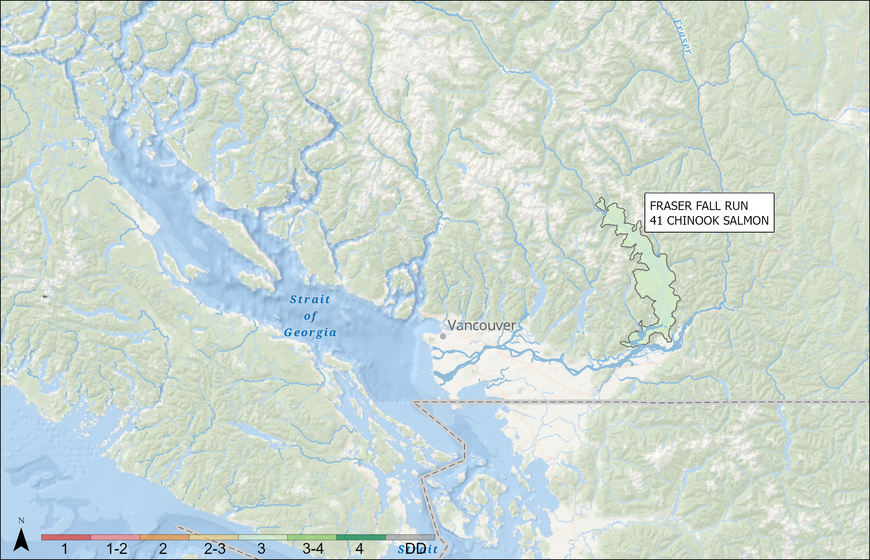
OUTLOOKS – FRASER AND INTERIOR
Fraser River and Interior Chinook – Fall Run 41
SMU | Resolution | CU | Outlook
FRASER FALL RUN 41 CHINOOK SALMON | CU (singular) | LOWER FRASER RIVER_FA_0.3 | 3
FRASER FALL RUN 41 CHINOOK SALMON |  | HATCHERY EXCLUSION-LOWER FRASER RIVER | 4
Notes:
FRASER FALL RUN 41 CHINOOK SALMON: The 2025 escapement for the Fraser Fall Run 41 SMU was above the long-term average, the 2021 parental brood escapement, and the escapement target (SMSY 75,100). This is the 4th consecutive year of meeting the escapement target, and we assigned an outlook category of 3 to the SMU. CK-03 has a WSP Amber Status (2023) and was above the average escapement in 2025. Expectations for 2026 are for continued above average abundance based on the higher 2022 brood year escapement and improved productivity in recent years. Escapement was around 60,000 this year and it has been above the long-term average since 2019. Escapement was around 60,000 this year and it has been above the long-term average since 2019

Slide 30
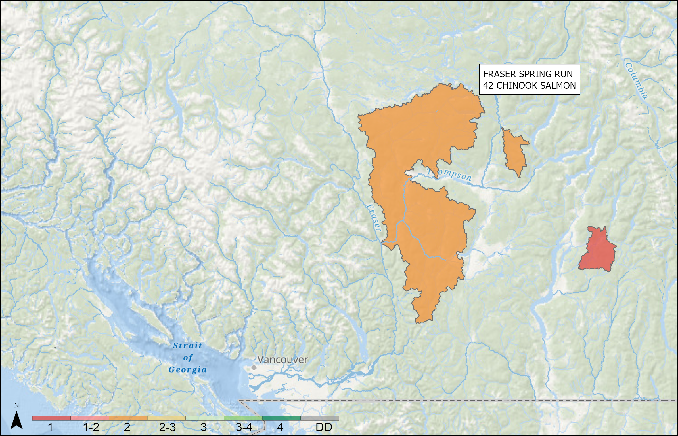
OUTLOOKS – FRASER AND INTERIOR
Fraser River and Interior Chinook – Spring Run 42
SMU | Resolution | CU | Outlook
FRASER SPRING RUN 42 CHINOOK SALMON | CU (singular) | SOUTH THOMPSON-BESSETTE CREEK_SU_1.2 | 1
FRASER SPRING RUN 42 CHINOOK SALMON | CU (singular) | LOWER THOMPSON_SP_1.2 | 2
Notes:
FRASER SPRING RUN 42 CHINOOK SALMON: The 2025 escapement for the Fraser Spring Run 42 SMU was below the long-term average, the 2021 parental brood escapement, and the escapement target (SMSY 22,100). We assigned an Outlook category of 1 to the SMU. CK-16 has a WSP Red status (2024) and was below the average escapement in 2025. CK-17 has a WSP Amber Status (2024) and was below average escapement in 2025. Expectations are for continued low abundance in 2026 due to low parental spawner abundance in 2022 combined with very low hatchery production for that cohort.

Slide 31
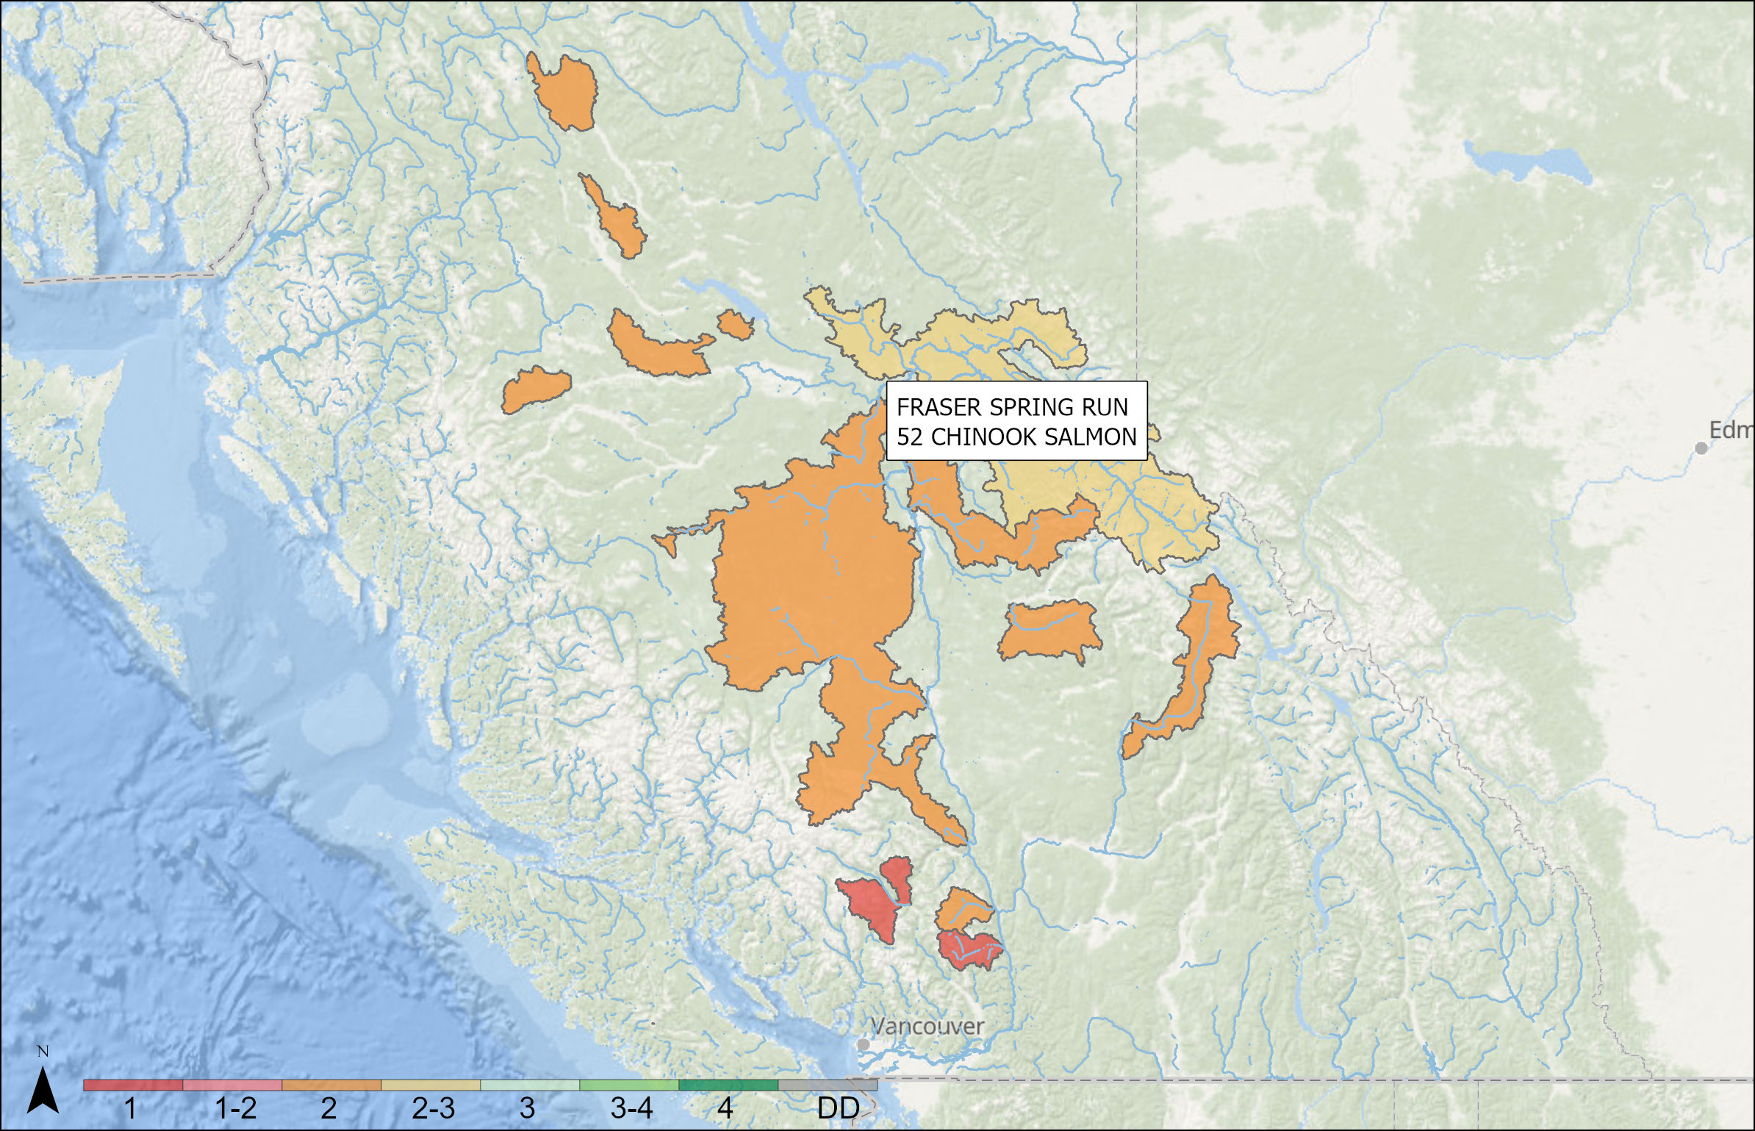
OUTLOOKS – FRASER AND INTERIOR
Fraser River and Interior Chinook – Spring Run 52
SMU | Resolution | CU | Outlook
FRASER SPRING RUN 52 CHINOOK SALMON | CU (aggregate) | MIDDLE FRASER-FRASER CANYON_SP_1.3, LOWER FRASER RIVER_SP_1.3 | 1
FRASER SPRING RUN 52 CHINOOK SALMON | CU (aggregate) | MIDDLE FRASER RIVER_SP_1.3, NORTH THOMPSON_SP_1.3 | 2
FRASER SPRING RUN 52 CHINOOK SALMON | CU (singular) | UPPER FRASER RIVER_SP_1.3 | 2 to 3
Notes:
FRASER SPRING RUN 52 CHINOOK SALMON: The 2025 escapement for the Fraser Spring Run 52 SMU was above the long-term average, the 2020 parental brood escapement, but below the escapement target (SMSY 42,200). Despite an increase in abundance in 2025, we assigned an Outlook category of 1 to the SMU as two conservation units remain in category 1. There continues to be considerable escapement variation among and within conservation units in 2025. CK-04 has a WSP Red Status (2024) and was well below the average escapement. CK-08 has a WSP Red Status (2024) and was above the average escapement. CK-10 has a WSP Amber Status (2024) and was below the average escapement. CK-12 has a WSP Amber Status (2024) and was above the average escapement. CK-18 has a WSP Amber Status (2024) and was below the average escapement. Expectations for 2025 are for continued low abundance compared to the escapement targets due to uncertainty around freshwater and marine survival and productivity.

Slide 32
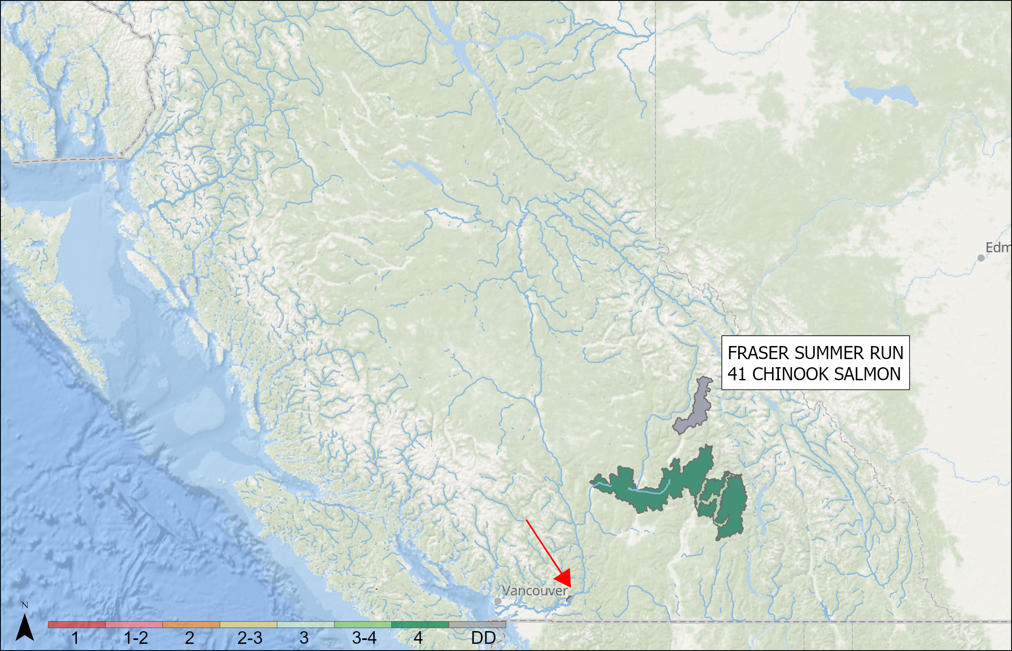
OUTLOOKS – FRASER AND INTERIOR
Fraser River and Interior Chinook – Summer Run 41
SMU | Resolution | CU | Outlook
FRASER SUMMER RUN 41 CHINOOK SALMON | CU (singular) | MARIA SLOUGH_SU_0.3 | 1
FRASER SUMMER RUN 41 CHINOOK SALMON | CU (singular) | SOUTH THOMPSON_SU_0.3 | 4
FRASER SUMMER RUN 41 CHINOOK SALMON | CU (singular) | SHUSWAP RIVER_SU_0.3 | 3
FRASER SUMMER RUN 41 CHINOOK SALMON | CU (singular) | UPPER ADAMS RIVER_SU_1.X | Data Deficient
Notes:
FRASER SUMMER RUN 41 CHINOOK SALMON: The 2025 escapement for the Fraser Summer Run 41 SMU was above the long-term average, the 2021 parental brood escapement, and the escapement estimated to produce the maximum sustained yield (SMSY 120,300). Despite continued high abundance for this SMU, we assigned an outlook category of 1 as a conservation unit (CK-07) remains in category 1. There continues to be different escapement trends among conservation units. CK-07 has a WSP Red Status (2023) and has been declining substantially in recent years, with 2025 well below the average escapement. CK-13 has a WSP Green Status (2023) and continues to have high spawner abundance, with 2025 more than double the average. CK-15 has a WSP Green Status (2023) and was above the average escapement in 2025. Similar trends are expected in 2026 with continued high abundances for CK-13 and CK-15, and very low abundance for CK-07.

Slide 33
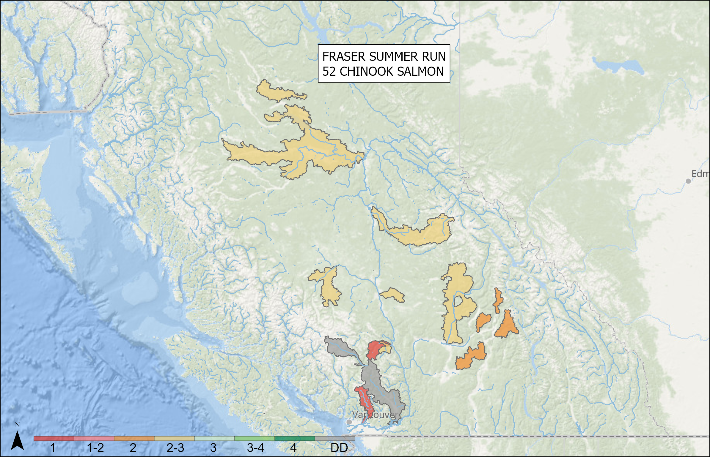
OUTLOOKS – FRASER AND INTERIOR
Fraser River and Interior Chinook – Summer Run 52
SMU | Resolution | CU | Outlook
FRASER SUMMER RUN 52 CHINOOK SALMON | CU (singular) | LOWER FRASER RIVER_SU_1.3 | Data Deficient
FRASER SUMMER RUN 52 CHINOOK SALMON | CU (aggregate) | MIDDLE FRASER RIVER-PORTAGE_FA_1.3, LOWER FRASER RIVER-UPPER PITT_SU_1.3 | 1
FRASER SUMMER RUN 52 CHINOOK SALMON | CU (aggregate) | MIDDLE FRASER RIVER_SU_1.3, NORTH THOMPSON_SU_1.3 | 2 to 3
FRASER SUMMER RUN 52 CHINOOK SALMON | CU (singular) | SOUTH THOMPSON_SU_1.3 | 2
Notes:
FRASER SUMMER RUN 52 CHINOOK SALMON: The 2025 escapement for the Fraser Summer Run 52 SMU was above the long-term average and the 2020 parental brood escapement, and was near the escapement target (SMSY 23,600). Despite an increase in abundance in 2025, we assigned an Outlook category of 1 to the SMU as two conservation units remain in category 1. There continues to be considerable escapement variation among and within these conservation units in 2025. CK-05 has a WSP Red Status (2024) and was well below the average escapement. CK-06 is a data deficient CU and was below the average escapement. CK-09 has a WSP Red Status (2024) and was below average escapement. CK-11 has a WSP Amber Status (2024) and was above average escapement. CK-14 has a WSP Amber Status (2024) and was above average escapement. CK-19 has a WSP Amber Status (2024) and was above average escapement. Expectations for the 2026 return are for continued low abundance and high variation due to uncertainty around marine survival and productivity.

Slide 34
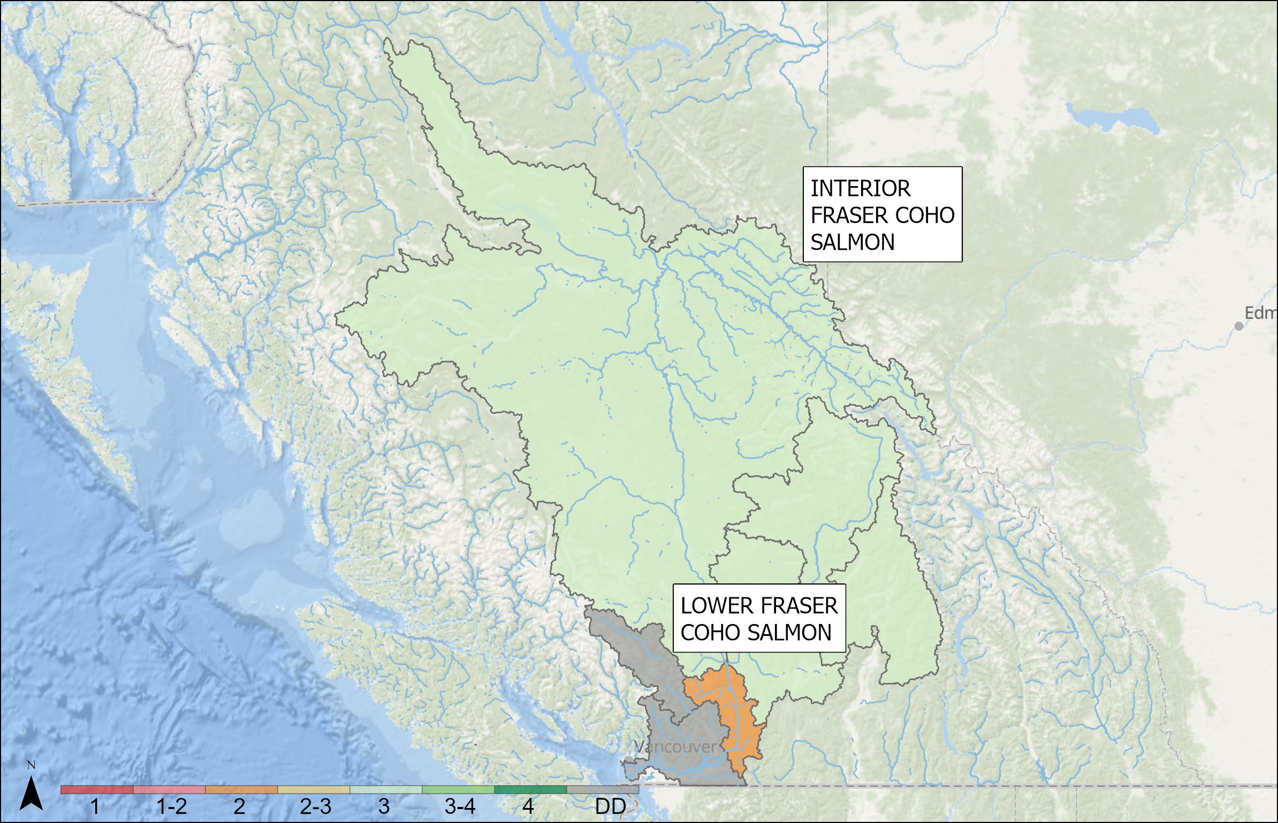
OUTLOOKS – FRASER AND INTERIOR
Fraser River and Interior Coho
SMU | Resolution | CU | Outlook
INTERIOR FRASER COHO SALMON | CU (singular) | FRASER CANYON | 2
INTERIOR FRASER COHO SALMON | CU (aggregate) | SOUTH THOMPSON, LOWER THOMPSON, INTERIOR FRASER, NORTH THOMPSON | 3
LOWER FRASER COHO SALMON | SMU | - | Data Deficient
Notes:
INTERIOR FRASER COHO SALMON: The PST MU status will remain Low in 2026, as the Moderate status reference point survival target has not been met; three consecutive years of survival over 3% are required for a change in status. Although the 2025 survival estimate is not available at this time, it will not impact MU status in 2026 as the 2023 survival estimate was 2.1%. Recent escapements exceed the PST MU Moderate status escapement target as well as the Canadian Fish Stock Provisions limit reference points. Total pre-fisheries abundance has improved but remains well below historical averages. IFC CU-level Wild Salmon Policy statuses are assessed using the Rapid Status Approach which is informed by recently adopted benchmarks from the 2025 Fisheries Science Response Report. 2025 escapement estimates, 2025 survival estimates, and 2026 preliminary forecasts are not available at this time. LOWER FRASER COHO SALMON: 2024 was the fourth successful year of estimating the aggregate terminal run and escapement for this PST MU. The average terminal run estimate for natural-origin LFC (191,000) exceeds the average for the hatchery-origin component (125,000). Currently, the Outlook Category cannot be determined for the natural component (only 4 years of data available, no LRP or management targets). Inch Creek Coho smolt-adult survival is a proxy for change in relative abundance for the MU. The 2024 marine survival estimate for this indicator stock was 11.2%, which is a 57% increase relative to the 2023 survival estimate (4.8%). Lower Fraser Coho hatchery production, marine survival, and fishery exploitation are expected to return sufficient abundance to achieve hatchery production objectives.

Slide 35
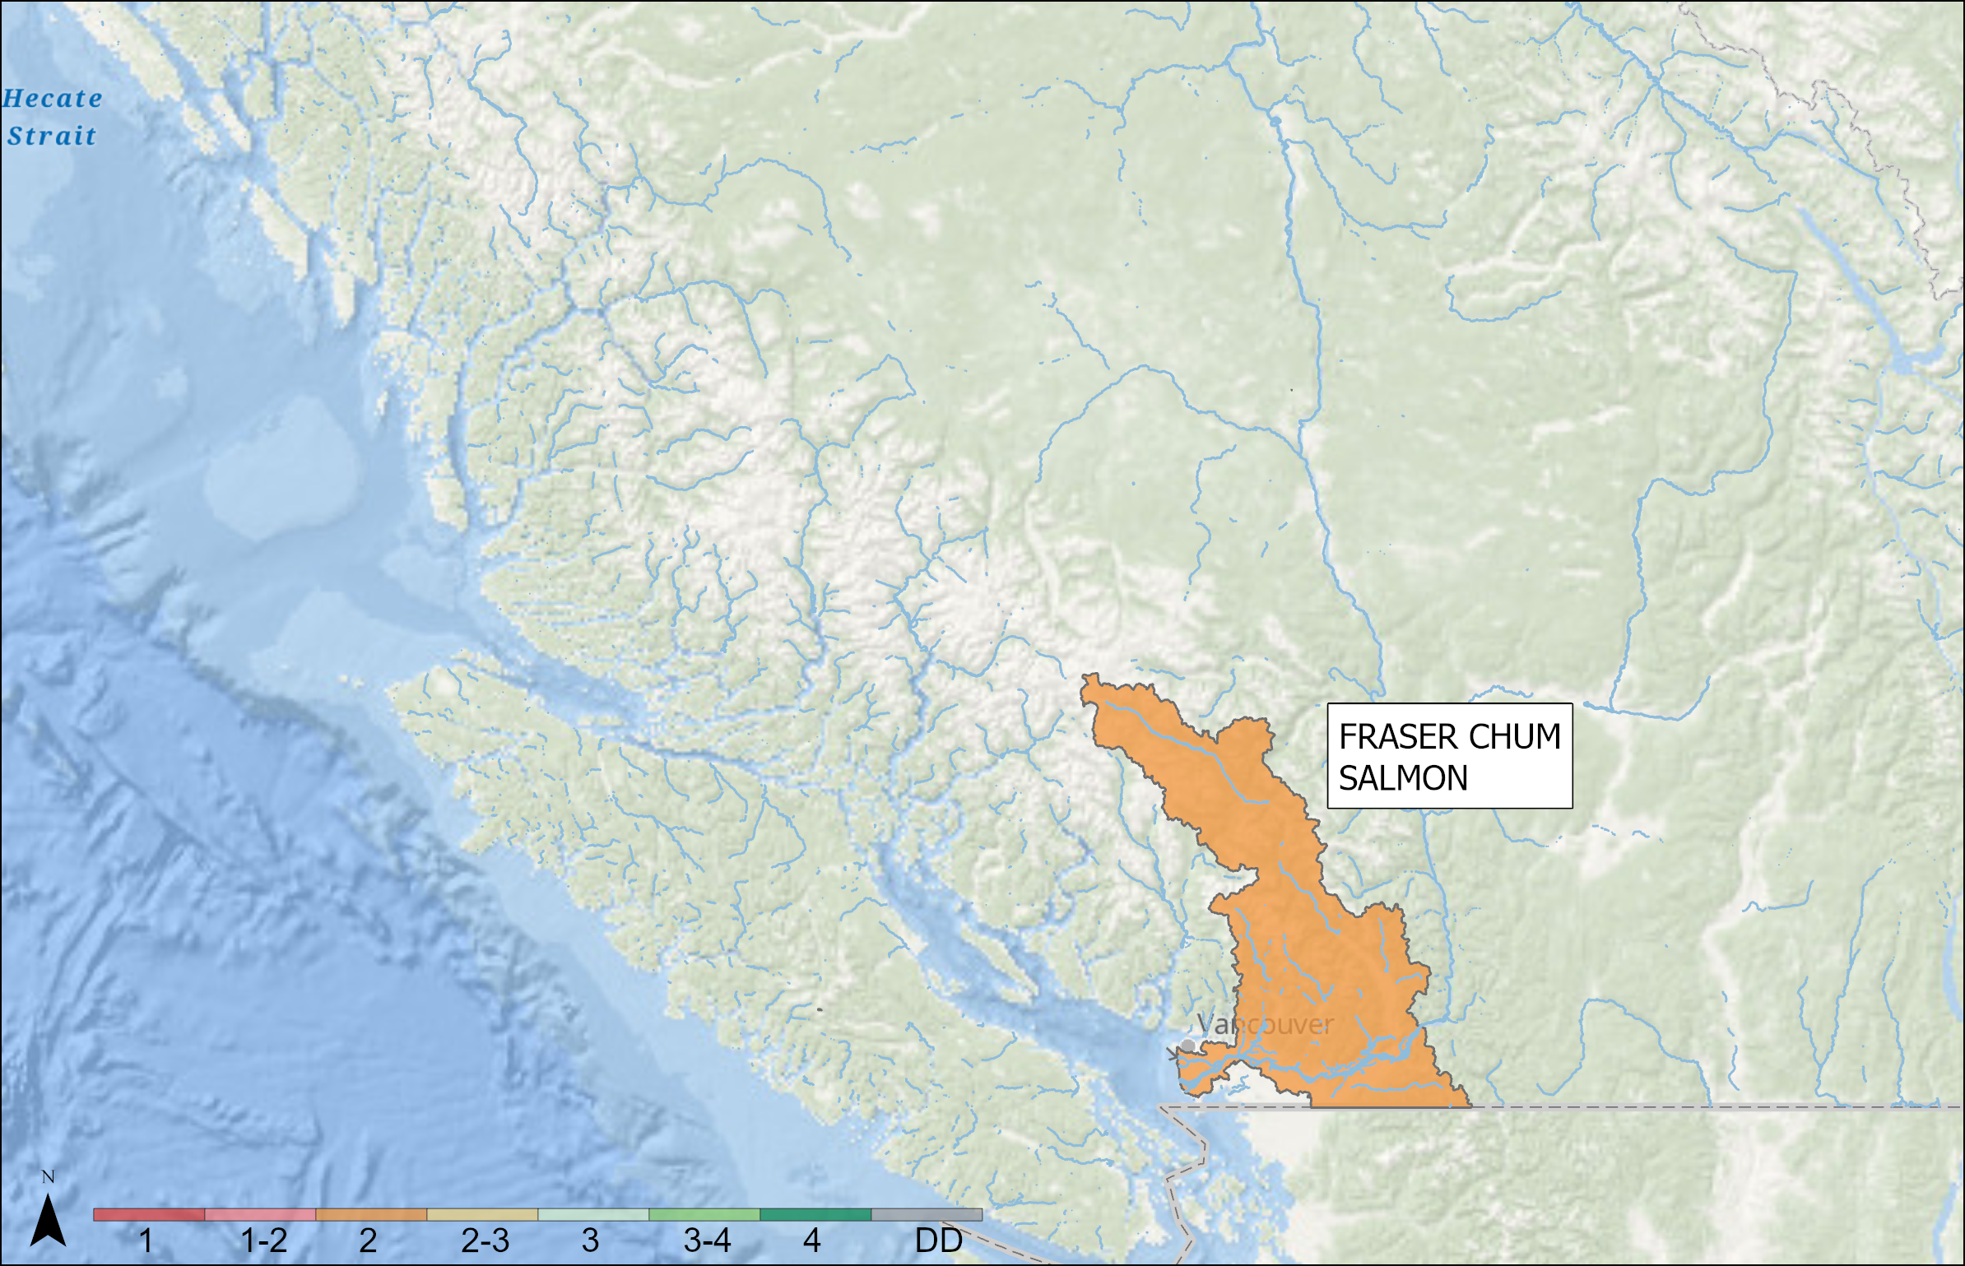
OUTLOOKS – FRASER AND INTERIOR
Fraser River and Interior Chum
SMU | Resolution | CU | Outlook | Forecast
FRASER CHUM SALMON | SMU | - | 2
FRASER CHUM SALMON | CU (singular) | FRASER CANYON | Data Deficient
FRASER CHUM SALMON | CU (singular) | LOWER FRASER | 2 | 1,130,000
Notes:
FRASER CHUM SALMON: Fraser Chum Salmon SMU is dominated by the Lower Fraser Chum CU. Lower Fraser River Chum Salmon spawning escapement has failed to reach the management target in six of the last eight years (2018-2021, 2023). The 2025 in-season terminal run estimate was 616,000 fish and the 2025 spawning escapement estimate (including age data) will be available by May 2026. Spawning escapements failed to outperform brood for 2017-2021, while spawning escapements outperformed brood in the most recent four years (2022-2025). Long term productivity is declining, and the Lower Fraser Chum CU was assigned a WSP Rapid Status Assessment of RED in 2025. Returns in 2026 will be dominated by 4-year-old brood from the 2022 escapement of 1,130,000 spawners. 2021 (530,000 spawners) and 2023 (620,000 spawners) were low escapement brood years, and are not expected to contribute significantly to the 2026 return. The high escapement brood-year and recently observed increases in productivity contrast with the observed long-term decrease in productivity: For 2026 the Lower Fraser Chum CU is assigned an Outlook Category 2. (2025 Outlook Category was 2)

Slide 36
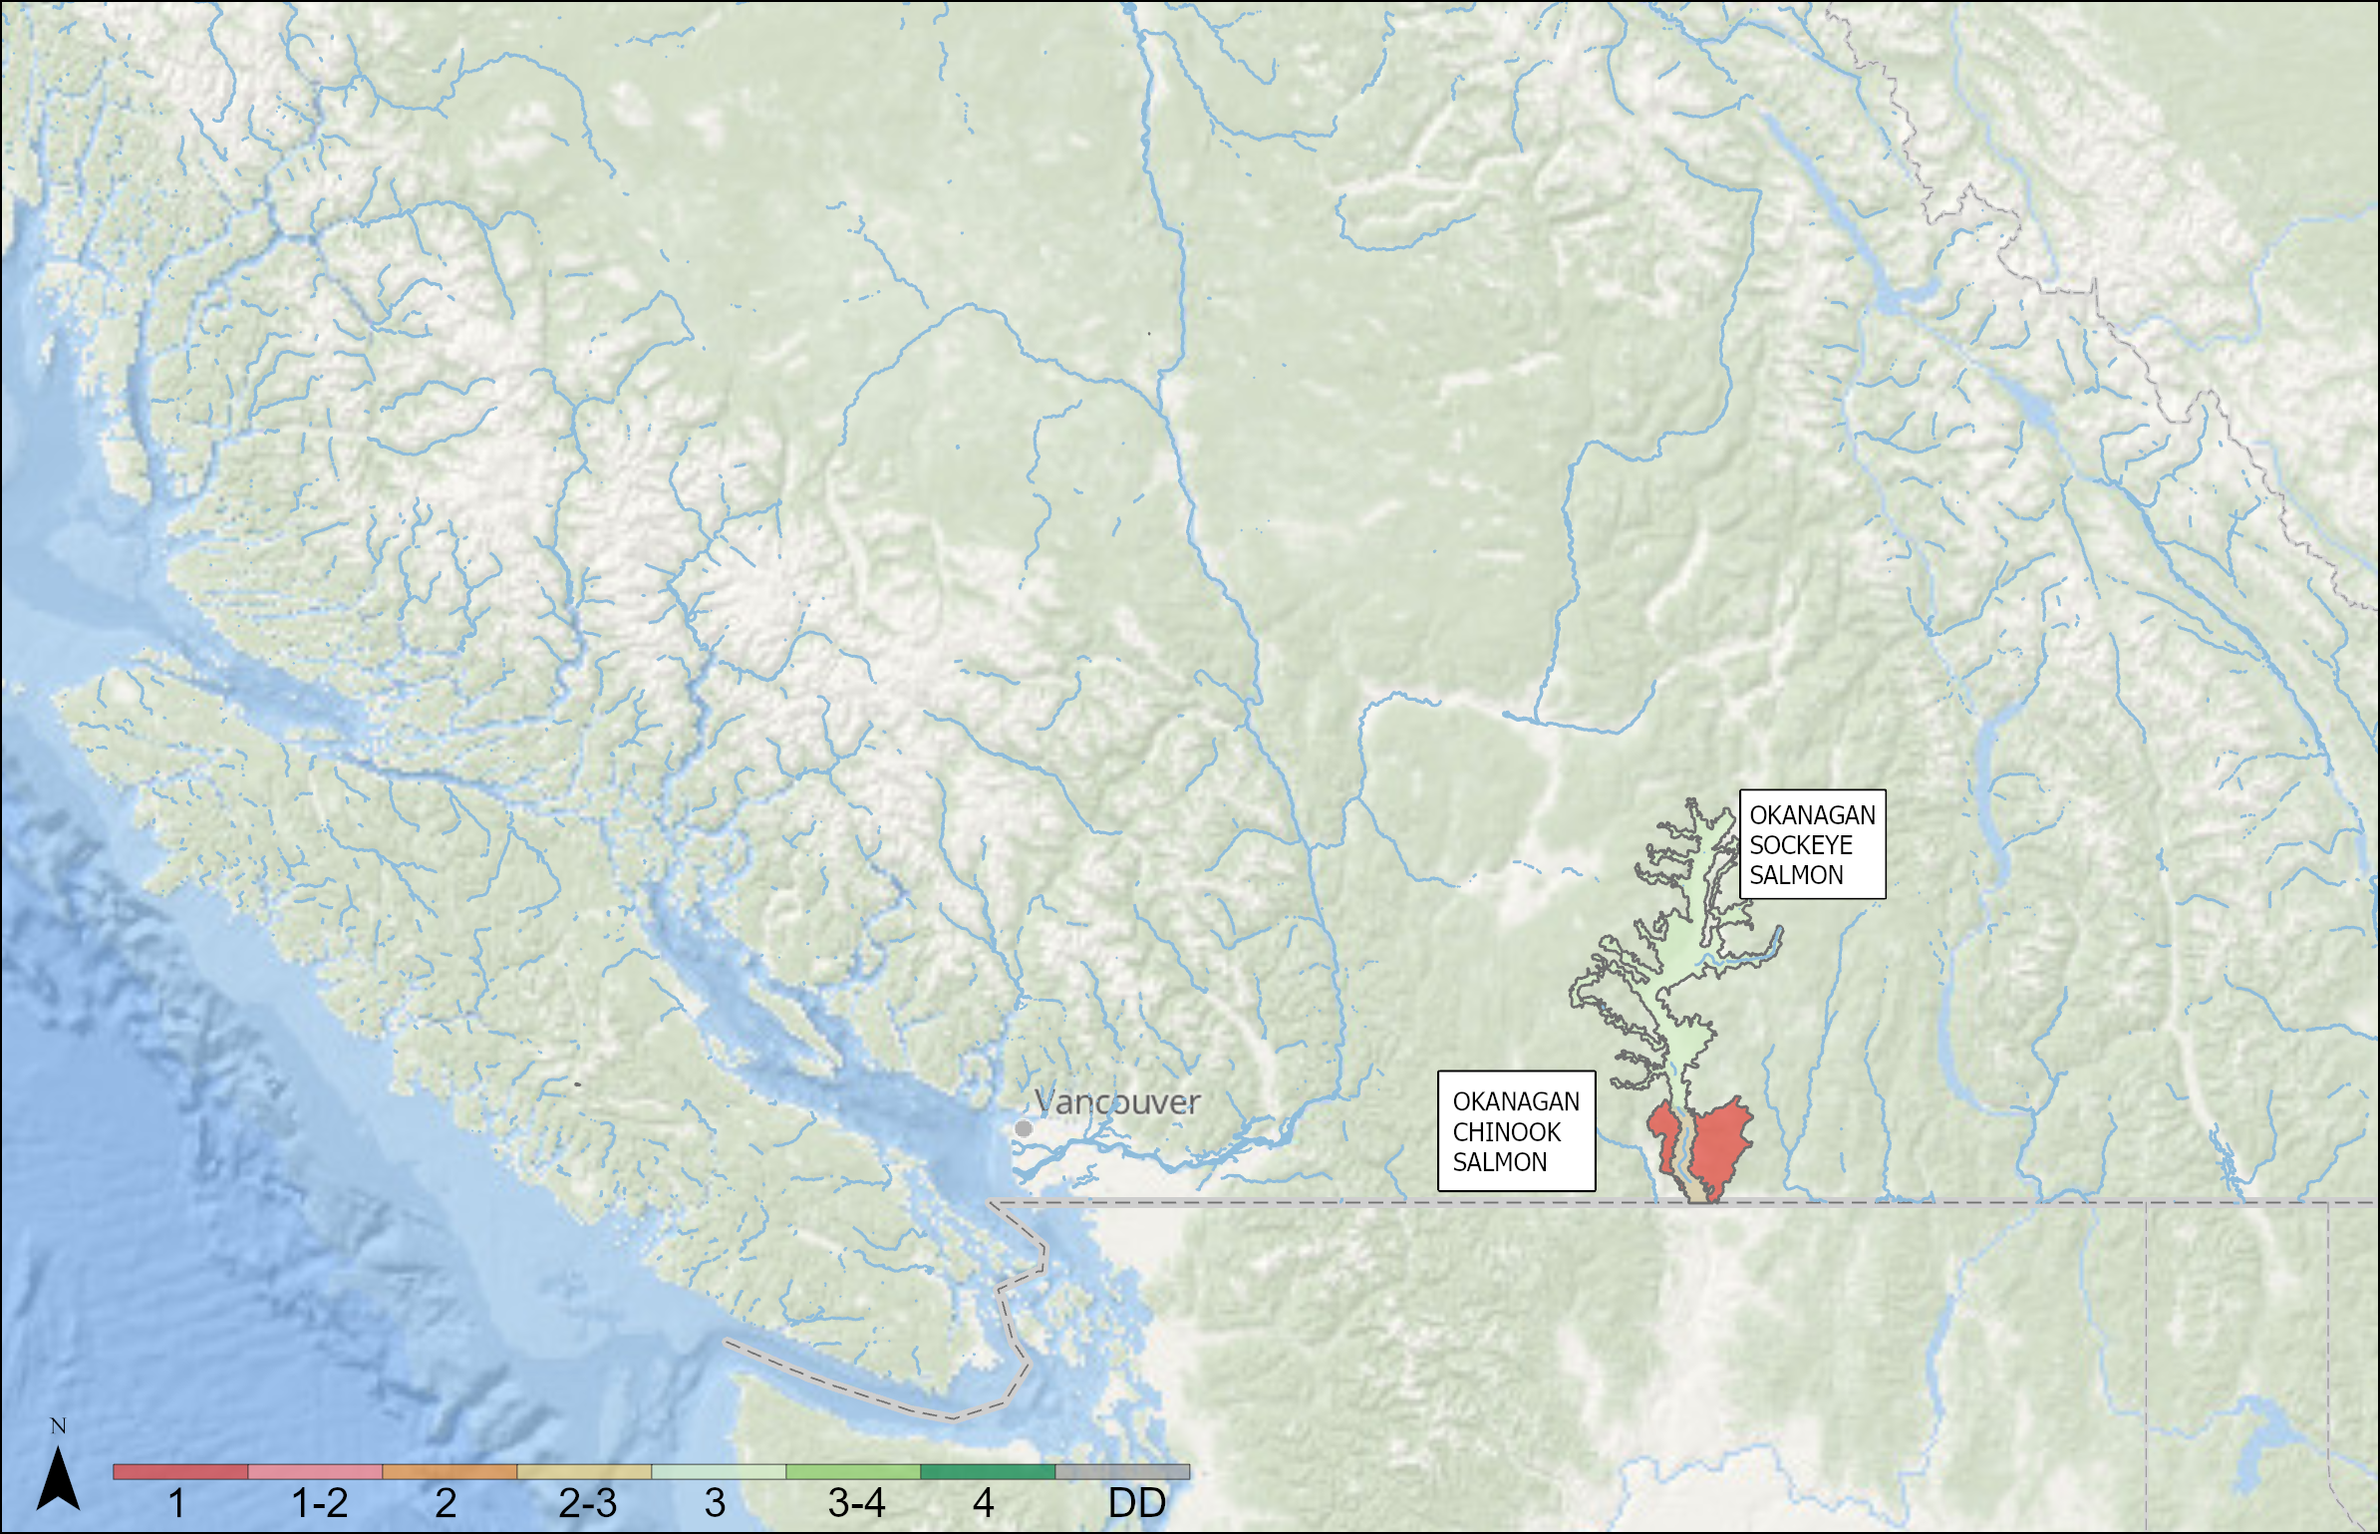
OUTLOOKS – FRASER AND INTERIOR
Fraser River and Interior Sockeye and Chinook – Okanagan
SMU | CU | Outlook | Forecast
OKANAGAN SOCKEYE SALMON |  | 3 | 184,000
OKANAGAN CHINOOK SALMON | OKANAGAN_0.X | 1
NO DESIGNATED SMU (Boundary Bay Chinook) | CK-02 | 1
Notes:
OKANAGAN SOCKEYE SALMON: The Okanagan Sockeye Salmon Stock Management Unit (SMU) includes a single CU, the Osoyoos-Skaha-Okanagan Sockeye Salmon Conservation Unit. This SMU has a two-year cycle with even years being high. Based on this, recruitment to the mouth of the Columbia River is expected to be average to above average (compared to the last 15 years) in 2026. This forecast includes all Okanagan sockeye in the SMU, including both natural- and hatchery-origin fish returning to Osoyoos, Skaha, and Okanagan lakes. Upstream mortality can be high for this SMU, depending on temperatures and harvest along the Columbia River and the Okanogan River (U.S. spelling), prior to the fish entering Canada. Therefore, there is considerable uncertainty about the numbers that will reach the spawning grounds.
OKANAGAN CHINOOK SALMON: The 2025 escapement for the Okanagan Summer Chinook conservation unit was below the long-term average, the 2021 parental brood escapement, and well below the escapement target (4,600). CK-01 has a WSP Red Status (2023) and was below average escapement in 2025. The CU is currently undergoing review for listing under the Species at Risk Act. Expectations for 2026 are for continued depressed abundance related to low parental escapements, low marine and freshwater survival, low productivity, and low hatchery production.
Boundary Bay: The 2025 escapement for the Boundary Bay conservation unit was above the long-term average and the 2021 parental brood escapement, but it was below the escapement target (2,100). The majority of spawners were hatchery-origin in 2025. CK-02 has a WSP Red Status (2023) and was above the average escapement in 2025. The CU is currently undergoing review for listing under the Species at Risk Act. Expectations for 2026 are for continued low abundance related to low parental escapements and uncertainty around survival and productivity.

Slide 37
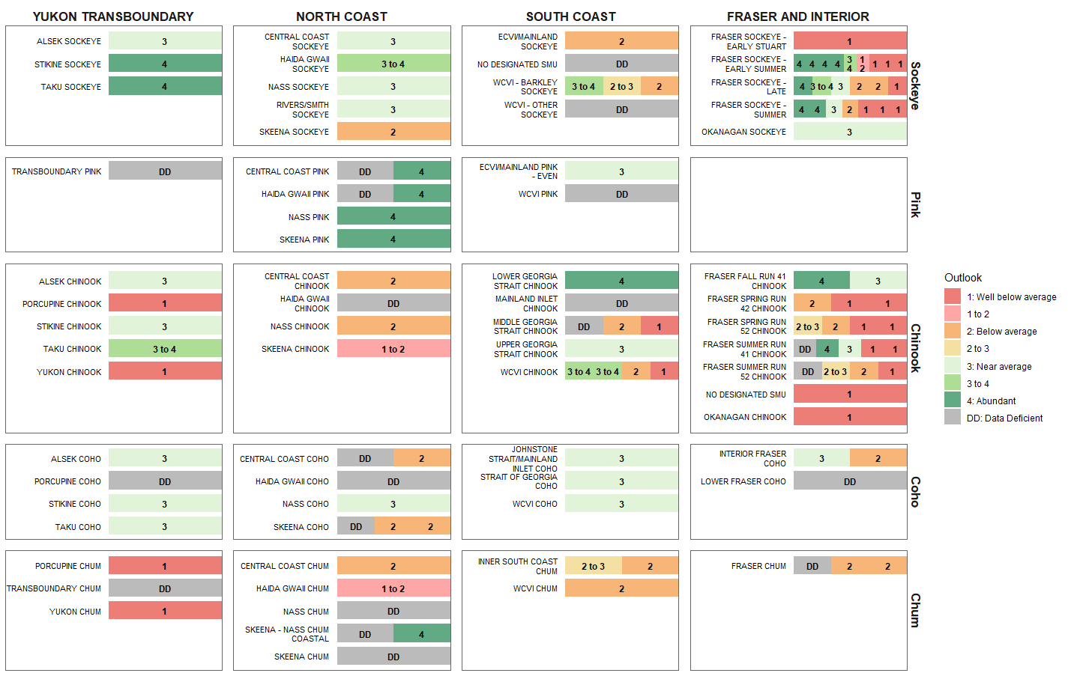
OUTLOOK OVERVIEW

Slide 38
CONCLUSION
Access Previous & Upcoming Outlooks
2024 Final Outlook
Pacific Salmon Outlook, Pacific Region 2024 (PDF)
2025 Final Outlook
Pacific Salmon Outlook, Pacific Region 2025 (PDF)
The final 2026 Outlook will be posted on the DFO Library once forecasts are completed
The SMU-CU-DU Crosswalk is available on GitHub

